Slide 2
Agenda
About the course
Course Structure
Introduction
Basic of networking
Basics of Storage and it’s role in computing
Storage technologies and Protocols
Storage Applications
Current trends in storage technology
Today’s Topic
Motivation to study storage :data explosion
Computer System Architecture
Memory Hierarchy

Slide 3
Moore’s Law fueling growth
“ If all engineering disciplines had kept pace with technological advancement in Electronics & IT, then
Boeing 747 would cost $500
It will take two hours to travel across the world
It would consume only 2 gallons of fuel “

Slide 4
What is Data ?
Collection of facts from which conclusion can be drawn
Data refers to a collection of organised information, usually the result of experience, observation or experiment

Slide 5
Why Data is growing
Process
Information
Process
Knowledge
Data
Data
Information
Knowledge
Better Decision Making

Slide 6
Human Behavior
“ Ye Dill Mange More”
Collect More
Collect specifically
Collect if you can

Slide 7
Quest for information & knowledge is leading to data explosion
It is predicted that more data will be produced in the next year than has been generated during the entire existence of humankind!
IBM predicts that by 2005 the amount of information on the planet will increase from 3.2million exabytes to 43 million exabytes.

Slide 8
What is Driving the Data Explosion?
The Internet, comprehensive application software, and new computing and storage technologies have made it easier to create, collect, and store all types of data.

Slide 9
Data Explosion Problem
Data Collection and Recording
Data Generation
Data Replication and Distribution

Slide 10
Data Explosion: Data collection
Examples of data collection*:
Birth certificates by hospitals in the U.S. (Illinois)
1983: 280 bytes, 4 attributes
1996: 1864 bytes, 263 attributes
Grocery store purchase entry
1983: 32 bytes , 3 attribute
1996: 1272 bytes, 108 attributes
More generally,
Businesses collecting more information 24x365
New (automated) technologies for data collection
e.g. RFID, http request mining and cookies, mining of emails

Slide 11
Data Generation - Case Mass General Ortho
Massachusetts General Hospital, State of Massachusetts, U.S.A - Orthopedic Department)
Serves 100 (new) patients a day // information on the Mass General website
3 X-Ray images per patient // guesswork :-)
Images are stored in digitized form
Average X-ray image size is 40cm x 25cm
Resolution of images: 20 pixels per mm. // Fuji Film data
Each pixel has 8 grey levels (i.e. 3 bits per pixel)
HIPAA (U.S. government) regulations - digital records must be stored for 7 years.
Required size: approx. 1.15 Tera Bytes
Recalculate for changes
Color images? 3-D images?

Slide 12
Data Generation - Case Genome Database (simplistic)
Simplest organism (bacterium) - approx. 600,000 base pairs
Human or Mouse Genome - 3 billion base-pairs
Each base pair requires 2x2 bits
(two bits each for identifying A,G,C, or T and the counterpart)
A database of genomes of 2000 complex organisms (say at least 1 billion base pairs)
Total size: 1 Terabytes

Slide 13
Data Generation- A more complicated case:
video picture through electron microscopy of bio-mass of a sphere of radius 1mm
E.g. the eye of a fly
Typical Video resolution 1nmx1nmx20nm
Vol = 4/3 * PI * r³ =_{approx.} 4 mm³
# pixels = 4 * 10⁶ * 10⁶ * 5 * 10⁴ = 20 * 10¹⁴
Compute the size for 1 frame.
@ 1 byte per pixel
2 * 10¹⁵ bytes = 2 PetaBytes
Compute the size for 1 minute video at 30 frames per second
60 * 30 * 2 PB = 3.6 ExaBytes

Slide 14
Data Replication: Examples
Case Google Search: #web pages
8 billion of (11.5billion) in 2005
30 K to 100K each (say average, 50K)
Approx. 400 TeraBytes
Case Google Earth
70 TB for raw images in 2006
Case Cuil – the latest search engine
121 billion web pages in 2008
approx. 6 PetaBytes

Slide 15
Google
1998 : Google Beta Handled 10000 queries a day
1999 : 3 million searches per day,
2000 : 18 Million queries a day ,Billion web searchable document
2001-2002:3 billion searchable web documents, 250 M images, 1200 catalogs
2004-2007: 6 billion items (including the 4.28 billion web pages , 880 million images, 845 million Usenet messages

Slide 16
Google
Web based Mail services with More than 2 GB storage space to each users.
Digital & satellite image mapping
Google Print (Library Digitization)

Slide 17
Data Explosion
Websites are replicated for distribution:
Consider Yahoo!, AOL TimeWarner, Google or MSN
Sites with the largest number of visitors
100+ million per month (for each site)
Problem: Not all users are in the same (geo) location.
Solution: Replicate and Distribute –
Referred to as “Akamaization” after Akamai Corp.
Copies of frequently referred sites are cached close to the user
Data Explosion:
Billions of pages replicated in dozens!

Slide 18
Data Explosion
Data quality (resolution)
Refer to example data collections
Data Availability and Access
Copies/Replicas for simultaneous access or low latency access
All major websites are “Akamaized”
Copies/Replicas for fault tolerance / disaster recovery
Companies were up and running within a few hours after WTC collapse
Data Permanence
Regulatory Compliance
HIPAA (U.S. Govt.) requires 7 years of data to be stored by hospitals
Sarbanes-Oaxley (U.S. Govt.) requires documentation on corporate governance
i.e. all corporate decisions / deliberations must be recorded i.e. all emails must be saved (forever??)
Data Provenance
Tracking of origin and lifecycle (i.e history) of data

Slide 19
Data Explosion
High volume requirements drive the market – vicious cycle?
Low cost storage
Leads to Increased access to storage
Cost per byte on hard disk < Cost per byte on paper
160GB off-the-shelf hard disk costs around Rs. 1600
i.e. a byte of hard disk space costs Rs. 10⁻⁸
Personal / Organizational storage is more affordable
Personal Multimedia content (mp3 songs, digicam/mobile pictures/videos) is increasing
Organizational examples:
All Course content is online and growing;
All questions answered on the web – volume of a sphere?
every technology has its website (dhcp.com, snia.org, …)
Mass storage services are feasible
Gmail gives 10+x GB, x is monotonically increasing over time
Already > 1.2 billion email users (not all in Gmail) and growing
Blog sites, social networking sites {orkut, youtube, myspace,facebook}, {naukri, monster, shine}.coms, Pornographic sites, …

Slide 20
Data Explosion
Nothing is ever deleted from websites – local or global!
Data is the new entropy!!!
Tera < Peta < Exa < Zetta < Yotta
Exercise:
How many zeroes in “Yotta”? [No cheating: don’t write a program ☺

Slide 21
Data & Storage Characteristics
Data
May be transactional or stream data
But 80% of data is “semi-structured” or “unstructured”:
X-Ray image does not have any structure
A website (in HTML) is semi-structured
Is business critical
Storage
Must be highly available
With redundancy/replication and across non-local networks
Must provide high data rates
Must support both streaming and transactional access!

Slide 22
Power Requirement
2005 : 1.6 % of total electrcity produced is used by servers and associated infrastructure
5000 MW in U.S.A , $2.7 Billion
14000 MW for rest of world , $7.2 B

Slide 23
Introduction to storage basics

Slide 24
Role of storage in IT
Storage is One of the three major IT infrastructure
Computing
Networking
Storage
We often think these as three layers

Slide 25
Role of Storage in IT- 3 Tier Architecture
Computing
Apps such as web servers, databases, streaming etc.
Networking
Provides connectivity between computing nodes
e.g. web service running on a computing node talks to a database service running on another computer
Storage (Persistent + Non-Persistent)
All data resides

Slide 26
Compute , network & storage layer
Application layer
Applications such as web servers ,data bases etc. live and run in compute layer
Network layer
offers connectivity between computing nodes eg. web server talking to database server
Storage layer :
all data reside in this layer

Slide 27
Types of storage
Persistent storage
It does not loose its content when power is turned off
It is standard choice for long term data
Eg. Tape, hard disk, flash memory
Non persistent
It looses data when power is turned off
Eg. Static / dynamic RAM
Storage refers to persistent non volatile storage where memory refers to non persistent technology

Slide 28
Crash Consistent
Data that is only partially written when the power is switched off will be only partially written

Slide 29
Computer System Architecture
Memory
Computational vs. Persistent
Memory Hierarchy
Cost and Access time
Caching and Multi-Level memory
Locality of Reference

Slide 30
Memory Requirements
Per computation data and Permanent (Persistent) data
Separate memory/storage required for both
Technology driven
Volatile vs. Non-volatile
Cost driven
Faster and Costlier vs. Slower and Cheaper

Slide 31
Memory Bandwidth Requirement
 | DEC VAX 11/780 (circa ‘80) | Early pipelines (circa ‘90) | Superscalars (circa ‘00) | Hyperthreaded Multi-cores (circa ‘08)
Clock Cycle | 250ns | 25ns | 1ns | 0.4ns
Instructions per cycle | 0.1 | 1 | 2 (4-way) | 8 (quad core,2 threads/core
Instructions per second = Cycles per second * Instructions per cycle
Instructions per second | 4 * 10⁵ | 40 * 10⁶ | 2 * 10⁹ | 20 * 10¹⁰

Slide 32
Memory Bandwidth Requirement[4]
 | DEC VAX 11/780 (circa ‘80) | Early pipelines (circa ‘90) | Superscalars (circa ‘00) | Hyperthreaded Multi-cores (circa ‘08)
Instructions per second | 4 * 10⁵ | 40 * 10⁶ | 2 * 10⁹ | 20 * 10¹⁰
Instruction Size | 3.8B | 4B | 4B | 4B
Operands in memory per instruction | 1.8 *4B | 0.3 *4B | 0.25*4B | 0.25*4B

Slide 33
Memory Bandwidth Requirement[5]
 | DEC VAX 11/780 (circa ‘80) | Early pipelines (circa ‘90) | Superscalars (circa ‘00) | Hyperthreaded Multi-cores (circa ‘08)
Instructions per second | 4 * 10⁵ | 40 * 10⁶ | 2 * 10⁹ | 20 * 10¹⁰
Instruction Size | 3.8B | 4B | 4B | 4B
Operands in memory per instruction | 1.8 *4B | 0.3 *4B | 0.25*4B | 0.25*4B
BW Demand = Instructions per second * (Instruction size + Operand size)
BW Demand | 4.4 Mbps | 208 Mbps | 10 Gbps | 100 Gbps

Slide 34
Memory subsystem design constraints
Three main constraints of memory subsystem design in computers
Size
Speed
Cost
Across the spectrum of the technologies following relationship holds
Smaller access time , greater cost per bit
Greater capacity, smaller cost per bit
Greater capacity , greater access time
Memory subsystem requirement
Large capacity, fast access time and low cost

Slide 35
Memory Hierarchy[1]
How do we meet memory bandwidth requirements?
Multiple levels
Early days – register set, primary, secondary and archival
Present day- register set, L1 cache, L2 cache, DRAM, direct attached storage, networked storage and archival storage
Motivation
Amortization of cost
As we move down the hierarchy cost decreases and speed decreases.

Slide 36
Memory Hierarchy[2]
How do we meet memory BW requirements?
Observation
A typical data item may be accessed more than once
Locality of reference
Memory references are clustered to a small region at any point of time during the execution of a typical program
Multiple levels
Early days – register set, primary, secondary and archival
Present day- register set, L1 cache, L2 cache, DRAM, direct attached storage, networked storage and archival storage

Slide 37
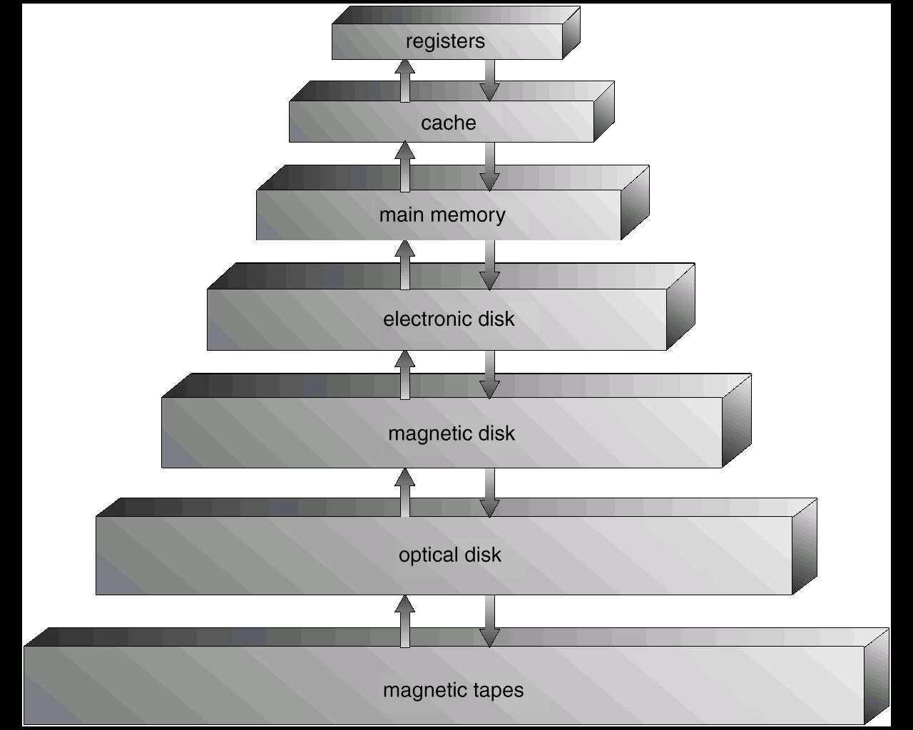
To meet the contradictory design requirement , organize memory in hierarchical manner

Slide 38
As one goes down the Hierarchy , the following conditions occur:
Decreasing cost per bit
Increasing capacity
Increasing access time
Decreasing frequency of access of the memory by the processor

Slide 39
Memory Technologies- Computational
Cache between CPU registers and main memory
Static RAM (6 transistors per cell)
Typical Access Time ~10ns
Main Memory
Dynamic RAM (1 transistor + 1 capacitor)
Capacitive leakage results in loss of data
Needs to be refreshed periodically – hence the term “dynamic”
Typical Access Time ~50ns
Typical Refresh Cycle ~100ms.

Slide 40
Memory technologies-Persistent
Hard Disks
Used for persistent online storage
Typical access time: 10 to 15ms
Semi-random or semi-sequential access:
Access in blocks – typically – of 512 bytes.
Cost per GB – Rs 5.50
Flash Devices (Solid State Drive)
Electrically Erasable Programmable ROM
Used for persistent online storage
Limit on Erases – currently 100,000 to 500,000
Read Access Time: 50ns
Write Access Time: 10 micro seconds
Semi-random or semi-sequential write:
Blocks – say 512 bits.
Cost Per GByte – U.S. $5.00 (circa 2007)

Slide 41
Memory Technologies-Archival
Magnetic Tapes
Access Time – (Initial) 10 sec.; 60Mbps data transfer
Cost per Gbyte – about 10c to 20c
Density – up-to 6.67 billion bits per square inch

Slide 42
Memory Hierarchy[3]
Multi-Level Inclusion Principle
All the data in level h is included in level h+1
Reasons?
Level h+1 is typically more persistent than level h.
Level h+1 is order(s) of magnitude larger.
When level h data has to be replaced (Why?),
Only written data needs to be copied.
Why is this good savings?

Slide 43
Example
Assume processor has access to two level of memory
Level 1 contains 1000 words and access time(T1) is 0.1 Micro second
Level 2 contains 100,000 words and access time (T2) is 1 Micro second
If the word is found in level 1 then it is accessed in 0.1 Micro sec else 1.1 micro sec

Slide 44
T1+T2
T2
T1
Fraction of access involving only level 1
1
0

Slide 45
Observation
We observe that if memory access at level 2 is less frequent then overall access time is close to level 1 access time
The basis for validity of this condition is a principal known as locality of reference
During course of execution of program , memory references for both data and instruction tends to cluster

Slide 46
Caching
L1, L2, and L3 caches between CPU and RAM
Transparent to OS and Apps.
L1 is typically on (processor) chip
May be separate for data and instructions (Why?)
L3 is typically on-board (i.e. processor board or “motherboard”)

Slide 47
Caching- Generic [1]
Caching as a principle can be applied between any two levels of memory
e.g. Buffer Cache (part of RAM)
transparent to App, maintained by OS, between main memory and hard disk,
Disk cache
between RAM and hard disk
typically part of disk controller
typically semiconductor memory
may be non-volatile ROM on high end disks to support power breakdowns.
transparent to OS and Apps

Slide 48
Caching- Generic [2]
Other examples:
network client cache – transparent to OS and apps.
web client (browser cache) - transparent to OS and apps.
proxy cache (client proxy, server proxy) – transparent to OS and apps;
client proxies are transparent to servers and vice-versa.
distribution cache – transparent to OS, apps, and clients or servers or both.

Slide 49
Next lecture
We have seen introduction and bit about memory
Basics of LAN technology
Ethernet, fast Ethernet, gigabit Ethernet
Concept of collision& broadcast domain
Network devices
Segmenting network using different network devices
Some protocols such as ARP, STP etc

Slide 50
Thank You!

Slide 51
Introduction to storage basics

Slide 52
Computer System Architecture
Memory
Computational vs. Persistent
Memory Hierarchy
Cost and Access time
Caching and Multi-Level memory
Locality of Reference

Slide 53
Memory Requirements
Per computation data and Permanent (Persistent) data
Separate memory/storage required for both
Technology driven
Volatile vs. Non-volatile
Cost driven
Faster and Costlier vs. Slower and Cheaper

Slide 54
Memory Bandwidth Requirement
 | DEC VAX 11/780 (circa ‘80) | Early pipelines (circa ‘90) | Superscalars (circa ‘00) | Hyperthreaded Multi-cores (circa ‘08)
Clock Cycle | 250ns | 25ns | 1ns | 0.4ns
Instructions per cycle | 0.1 | 1 | 2 (4-way) | 8 (quad core,2 threads/core
Instructions per second = Cycles per second * Instructions per cycle
Instructions per second | 4 * 10⁵ | 40 * 10⁶ | 2 * 10⁹ | 20 * 10¹⁰

Slide 55
Memory Bandwidth Requirement[4]
 | DEC VAX 11/780 (circa ‘80) | Early pipelines (circa ‘90) | Superscalars (circa ‘00) | Hyperthreaded Multi-cores (circa ‘08)
Instructions per second | 4 * 10⁵ | 40 * 10⁶ | 2 * 10⁹ | 20 * 10¹⁰
Instruction Size | 3.8B | 4B | 4B | 4B
Operands in memory per instruction | 1.8 *4B | 0.3 *4B | 0.25*4B | 0.25*4B

Slide 56
Memory Bandwidth Requirement[5]
 | DEC VAX 11/780 (circa ‘80) | Early pipelines (circa ‘90) | Superscalars (circa ‘00) | Hyperthreaded Multi-cores (circa ‘08)
Instructions per second | 4 * 10⁵ | 40 * 10⁶ | 2 * 10⁹ | 20 * 10¹⁰
Instruction Size | 3.8B | 4B | 4B | 4B
Operands in memory per instruction | 1.8 *4B | 0.3 *4B | 0.25*4B | 0.25*4B
BW Demand = Instructions per second * (Instruction size + Operand size)
BW Demand | 4.4 Mbps | 208 Mbps | 10 Gbps | 100 Gbps

Slide 57
Memory subsystem design constraints
Three main constraints of memory subsystem design in computers
Size
Speed
Cost
Across the spectrum of the technologies following relationship holds
Smaller access time , greater cost per bit
Greater capacity, smaller cost per bit
Greater capacity , greater access time
Memory subsystem requirement
Large capacity, fast access time and low cost

Slide 58
Memory Hierarchy[1]
How do we meet memory bandwidth requirements?
Multiple levels
Early days – register set, primary, secondary and archival
Present day- register set, L1 cache, L2 cache, DRAM, direct attached storage, networked storage and archival storage
Motivation
Amortization of cost
As we move down the hierarchy cost decreases and speed decreases.

Slide 59
Memory Hierarchy[2]
How do we meet memory BW requirements?
Observation
A typical data item may be accessed more than once
Locality of reference
Memory references are clustered to a small region at any point of time during the execution of a typical program
Multiple levels
Early days – register set, primary, secondary and archival
Present day- register set, L1 cache, L2 cache, DRAM, direct attached storage, networked storage and archival storage

Slide 60
To meet the contradictory design requirement , organize memory in hierarchical manner

Slide 61
As one goes down the Hierarchy , the following conditions occur:
Decreasing cost per bit
Increasing capacity
Increasing access time
Decreasing frequency of access of the memory by the processor

Slide 62
Memory Technologies- Computational
Cache between CPU registers and main memory
Static RAM (6 transistors per cell)
Typical Access Time ~10ns
Main Memory
Dynamic RAM (1 transistor + 1 capacitor)
Capacitive leakage results in loss of data
Needs to be refreshed periodically – hence the term “dynamic”
Typical Access Time ~50ns
Typical Refresh Cycle ~100ms.

Slide 63
Memory technologies-Persistent
Hard Disks
Used for persistent online storage
Typical access time: 10 to 15ms
Semi-random or semi-sequential access:
Access in blocks – typically – of 512 bytes.
Cost per GB – Rs 5.50
Flash Devices (Solid State Drive)
Electrically Erasable Programmable ROM
Used for persistent online storage
Limit on Erases – currently 100,000 to 500,000
Read Access Time: 50ns
Write Access Time: 10 micro seconds
Semi-random or semi-sequential write:
Blocks – say 512 bits.
Cost Per GByte – U.S. $5.00 (circa 2007)

Slide 64
Memory Technologies-Archival
Magnetic Tapes
Access Time – (Initial) 10 sec.; 60Mbps data transfer
Cost per Gbyte – about 10c to 20c
Density – up-to 6.67 billion bits per square inch

Slide 65
Memory Hierarchy[3]
Multi-Level Inclusion Principle
All the data in level h is included in level h+1
Reasons?
Level h+1 is typically more persistent than level h.
Level h+1 is order(s) of magnitude larger.
When level h data has to be replaced (Why?),
Only written data needs to be copied.
Why is this good savings?

Slide 66
Example
Assume processor has access to two level of memory
Level 1 contains 1000 words and access time(T1) is 0.1 Micro second
Level 2 contains 100,000 words and access time (T2) is 1 Micro second
If the word is found in level 1 then it is accessed in 0.1 Micro sec else 1.1 micro sec

Slide 67
T1+T2
T2
T1
Fraction of access involving only level 1
1
0

Slide 68
Observation
We observe that if memory access at level 2 is less frequent then overall access time is close to level 1 access time
The basis for validity of this condition is a principal known as locality of reference
During course of execution of program , memory references for both data and instruction tends to cluster

Slide 69
Caching
L1, L2, and L3 caches between CPU and RAM
Transparent to OS and Apps.
L1 is typically on (processor) chip
May be separate for data and instructions (Why?)
L3 is typically on-board (i.e. processor board or “motherboard”)

Slide 70
Caching- Generic [1]
Caching as a principle can be applied between any two levels of memory
e.g. Buffer Cache (part of RAM)
transparent to App, maintained by OS, between main memory and hard disk,
Disk cache
between RAM and hard disk
typically part of disk controller
typically semiconductor memory
may be non-volatile ROM on high end disks to support power breakdowns.
transparent to OS and Apps

Slide 71
Caching- Generic [2]
Other examples:
network client cache – transparent to OS and apps.
web client (browser cache) - transparent to OS and apps.
proxy cache (client proxy, server proxy) – transparent to OS and apps;
client proxies are transparent to servers and vice-versa.
distribution cache – transparent to OS, apps, and clients or servers or both.

Slide 72
Storage basics

Slide 73
Supporting technologies
Solid state storage
Upcoming & gaining popularity
Gives excellent performance for random read workload
Electro-magnetic storage
Existing for over 50 years
Excellent performance for sequential work load
400 MBps : 250 Mbps for 15 K RPM Disk

Slide 74
Storage Devices
Disk storage :
Solid State storage
Tape storage
Hybrid Disk

Slide 75
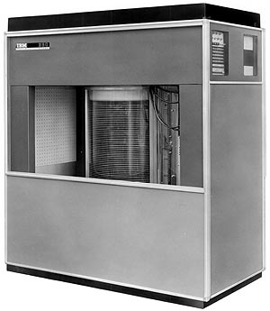
IBM RAMAC 350 disk
Developed in 1956
Height 66 inches
50 platters of size 24 inches
Weight : around 1 ton
Storage capacity : 4MB

Slide 76
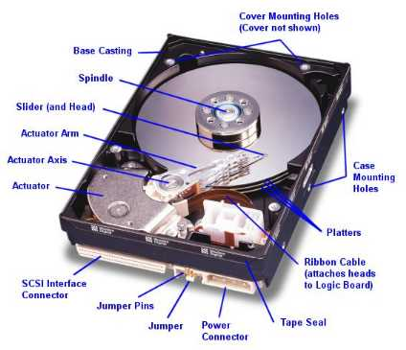

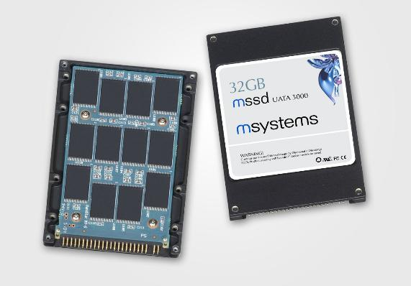
Mass Storage: HDD and SSD
Most popular: Magnetic hard disk drives
Solid state drives: (SSD)

Slide 77
Modern Disk Drives
Mechanism
Recording Components
Rotating Disk
Heads
Positioning Components
Arm Assembly
Track-following System
Controller
Microprocessor
Buffer Memory
Interface to SCSI bus

Slide 78
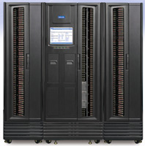
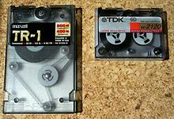
Magnetic Tape
Relatively permanent and holds large quantities of data
Random access ~1000 times slower than disk
Mainly used for backup, storage of infrequently-used data, transfer medium between systems
20-1.5TB typical storage
Common technologies are 4mm, 8mm, 19mm, LTO-2 and SDLT

Slide 79
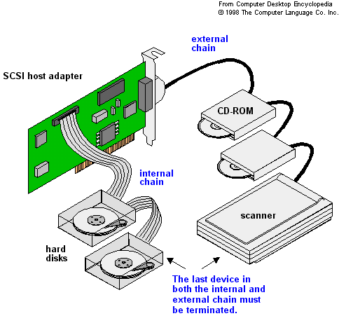
Disk Attachment
Drive attached to computer via I/O bus
USB
SATA (replacing ATA, PATA, EIDE)
SCSI
itself is a bus, up to 16 devices on one cable, SCSI initiator requests operation and SCSI targets perform tasks
FC (Fiber Channel) is high-speed serial architecture
Can be switched fabric with 24-bit address space – the basis of storage area networks (SANs) in which many hosts attach to many storage units
Can be arbitrated loop (FC-AL) of 126 devices

Slide 80
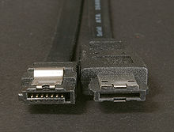
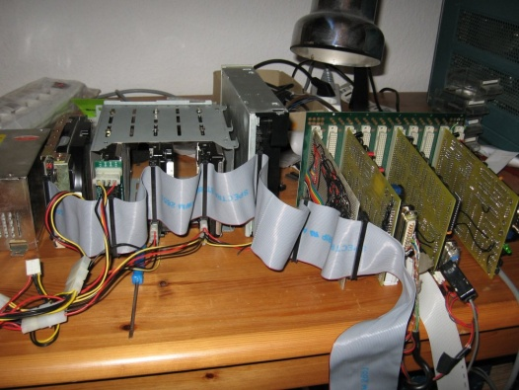
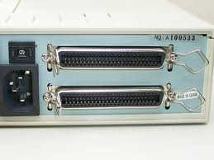
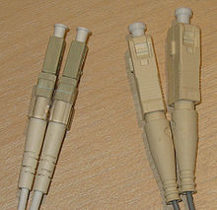
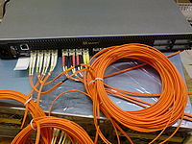
SATA connectors
SCSI
FC with SAN-switch

Slide 81
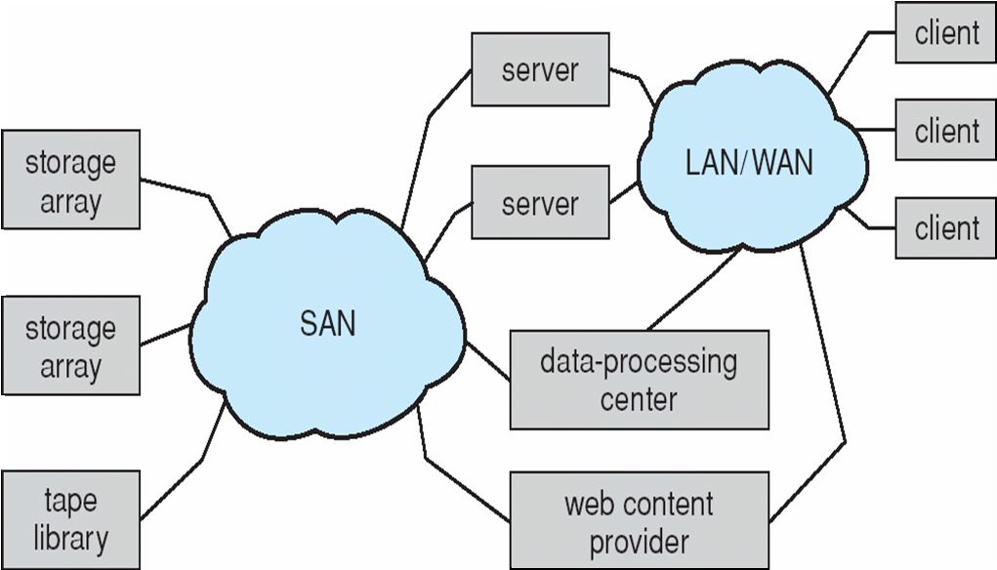
Storage Area Network (SAN)
Special/dedicated network for accessing block level data storage
Multiple hosts attached to multiple storage arrays - flexible

Slide 82
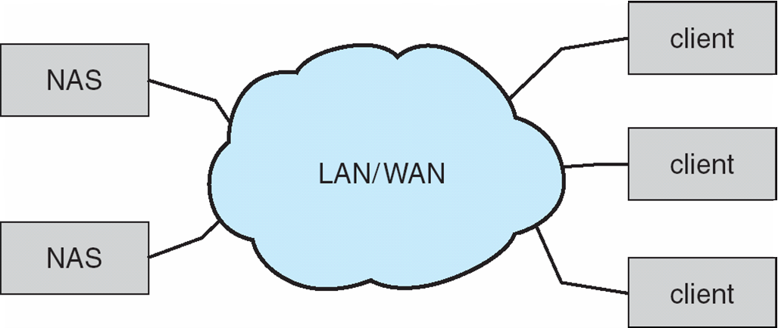
Network-Attached Storage
Network-attached storage (NAS) is storage made available over a network rather than over a local connection (such as a bus)
NFS and CIFS are common protocols
Implemented via remote procedure calls (RPCs) between host and storage
New iSCSI protocol uses IP network to carry the SCSI protocol

Slide 83
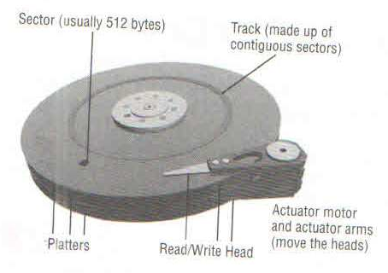
Anatomy of Disk
Major components of disk drives
Platters
Read write head
Actuator assembly
Spindle motor

Slide 84
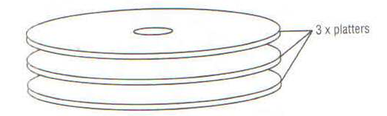
Platter
Are made up of glass or aluminum substrate
Is coated with material
It is rigid, thin, flat , smooth
All platters are attached to common shaft (spindle)
Rigidity & smoothness is very important . Any defect could result in head crash

Slide 85
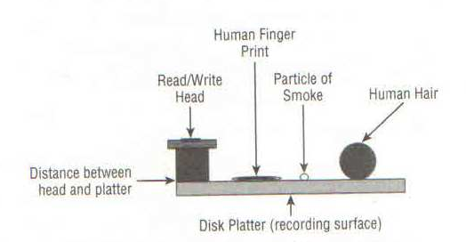
Read Write head
Head flies above the platter surface
Attached to actuator assembly
OS does not know any thing about read write head
Flying hight is measured in micrometers

Slide 86
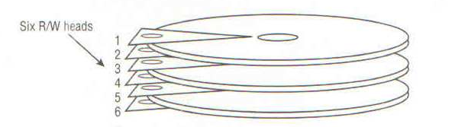
Head crash
Read /write head never touch platter. If they touch , it is known as head crash.
Head crash would always result in complete loss of data .
Each platter surface has its own read/write head
Concept ohead and recording surface gave rise to CSH addressing

Slide 87
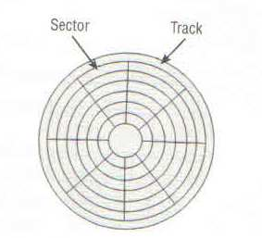
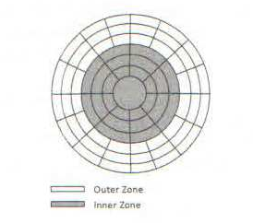
Tracks & Sectors
Surface of every platter is microscopically divided into tracks & sectors
Sector is the smallest addressible unit of a disk drive
Sector size is typically 512 bytes or 520 bytes
SATA (Serial Advance Technology Attachment) have fixed sector size of 512 bytes
FC ( Fiber channel ) and serial attached SCSI ( SAS) drives can be arbitrarily formatted to different size
This is important for implementation of data integrity technology for Endo to end data protection EDP
Read T10 DIF
8 bytes of data added to end of every 512 byte sector
This allows errors to be detected

Slide 88
Tracks & Sectors
Size of each sector is getting smaller and smaller towards the center .
The recording density being same , outer sectors waste space
Most modern disk implement Zoned Data Recording ( ZDR)
The outer track store and retrieve more data per spin
If data is read or written to contiguous sector of same or adjacent track we get better performance
Short stroking to achieve performance
Data could be stored only on outermost tracks
Reduced capacity , reduced load

Slide 89
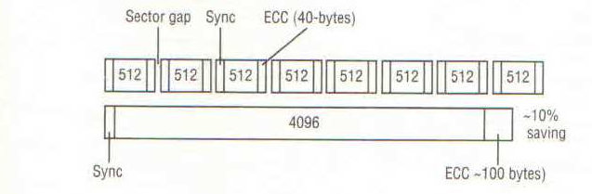
Larger sector size trend
512 byte sector requires 320 bytes for ECC
4K byte requires only 100 byte
Type of disk where size of sector is fixed and can not be changed is known as Fixed Block Architecture ( FBA)

Slide 90
Logical block addressing
Hides complexity of CSH based addressing
Is complex due to ZDR
Bad sector handling mechanism
LBA is implemented in drive controller
LBA to PBA mapping is required
OS or volume managers never know the precise location of the data on disk

Slide 91
Actuator & Spindle
Actuators are responsible for head movement .
All the heads are connected to single actuator they move at same time
All platters are mounted on single spindle
Each platter move at same speed

Slide 92
Controller
Each disk drive comes with its own controller
Controller has a processor, memory and it runs firmware
Controller hides the disk operation complexities
It maps Physical address to logical address and exposes LBA to OS/ Bios
Controller also monitors the health of disk
It also maintains the bad block map
Each drive has a number of hidden / spare block areused to remap bad blocks

Slide 93
Interface & protocols
Protocol is set of command and rules of communication
Disk drives , Solid state media follow a protocol
In storage domain protocols also define
Physical interface specification
Command sets

Slide 94
Common protocol & interfaces
Serial advance technology attachment (SATA)
Serial attached SCSI (SAS)
Nearline SAS ( NLSAS)
Fibre channel ( FC)

Slide 95
Serial advance technology attachment (SATA)
Low end computing , cheap, low performance, use low cost components, smaller buffer etc.
Used at lower tier of auto tiering solution

Slide 96
Serial attached SCSI (SAS)
Serial Point to point protocol
Uses SCSI command set
SAS drives are mkore expensive han SATA and offer better performance than sata
Used for high end applications
SAS drives are dual ported and each port can be connected to different controller resulting in higher performance and reliablity
FC drives implement SCSI command set but have dual FC-AL or dual FC Point to point interface
NL –SAS are hybrid of SAS and SATA
It has SAS interface , follows SAS protocol but uses SATA disk platters and components

Slide 97
Queing
All disk drive implement queuing
SATA implements Native Command Queuing (NCQ)
SCSI uses command tag queuing

Slide 98
HDD Form factor
Form factor | Hight | Width | Depth
3.5 inch | 1 inch | 4 inch | 5.75 inch
2.5 inch | 0.6 inch | 2.75 inch | 3.94 inch

Slide 99
Drive speed
5400 RPM
7200 RPM
10000RPM
15000 RPM ( 240 KM / hr)
Higher RPM better performance
Higher RPM lower the capacity
2.5 inch , 900Gb 10K
3.5 inch , 4 TB 7500RPM

Slide 100
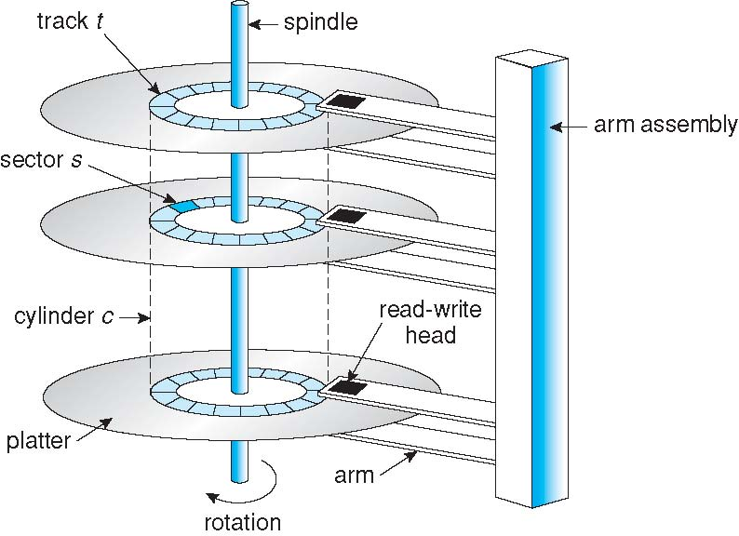
Moving-head Disk Mechanism

Slide 101
Disk performance
Seek time (15k 3.4 to 3.9ms) (7.2K 8.5 to 9.5 ms)
Rotational latency 15k 2ms 7.2k 4.16ms
Transfer time
Access time = seek time+ rot delay + transfer time
IOPS = 1 /(AST+ART) *1000
Eg 1/( 3.2+2)* 1000 = 181
Maximum and sustained data transfer rate
For 15K disks max 600 Mbps , 198 mBps

Slide 102
Estimate sustained average transferring rate
Suppose that a disk drive spins at 7200 RPM (revolutions per minute), has a sector size of 512 bytes, and holds 160 sectors per track.
What is sustained average transfer rate of this drive in megabytes per second?
.Disk spins 120 times per second (7200 RPM/60)
Each spin transfers a track of 80 KB (160 sectors x0.5K)
Sustained average transfer rate is 120x80 = 9.6MB/s.

Slide 103
Average performance of random access
7200 RPM, sector size of 512 bytes, and 160 sectors per track.
Average seek time for the drive is 8 milliseconds
Estimate # of random sector I/Os per second that can be done and the effective average transfer rate for random-access of a sector?
Disk spins 120 times per second
Average rotational cost is time to travel half track: 1/120 * 50%=4.167ms
Transfer time is 8ms to seek
+ 4.167 ms rotational latency
+ 0.052 ms (reading one sector takes 0.0005MB/ 9.6MB).
=12.219ms
# of random sector access/second= 1/0.012219=81.8
Effective transferring rate: 0.5 KB/0.012.219s=0.0409MB/s.

Slide 104
Disk Scheduling: Objective
Given a set of IO requests
Coordinate disk access of multiple I/O requests for faster performance and reduced seek time.
Seek time ≈ seek distance
Measured by total head movement in terms of cylinders from one request to another.
Hard Disk
Drive

Slide 105
Thank You!

Slide 106
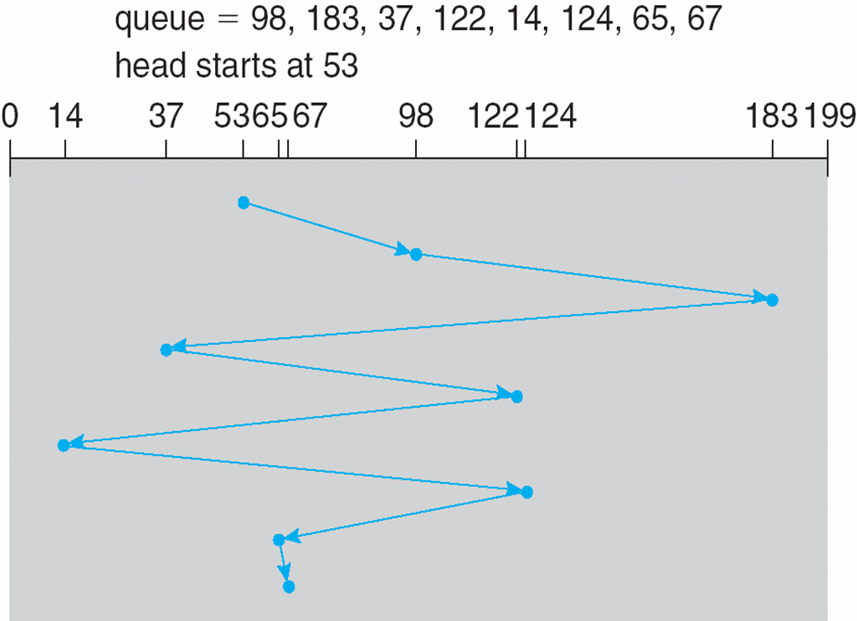
FCFS (First Come First Serve)
total head movement: 640 cylinders for executing all requests

Slide 107
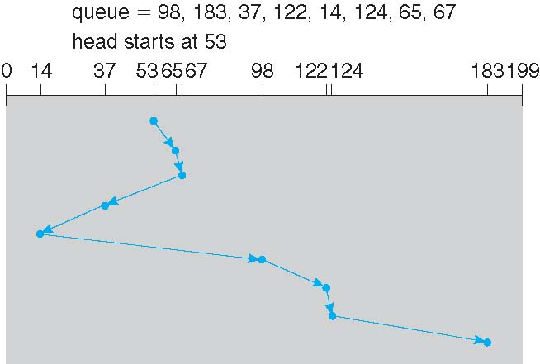
SSTF (Shortest Seek Time First)
Selects the request with the minimum seek time from the current head position
total head movement: 236 cylinders

Slide 108
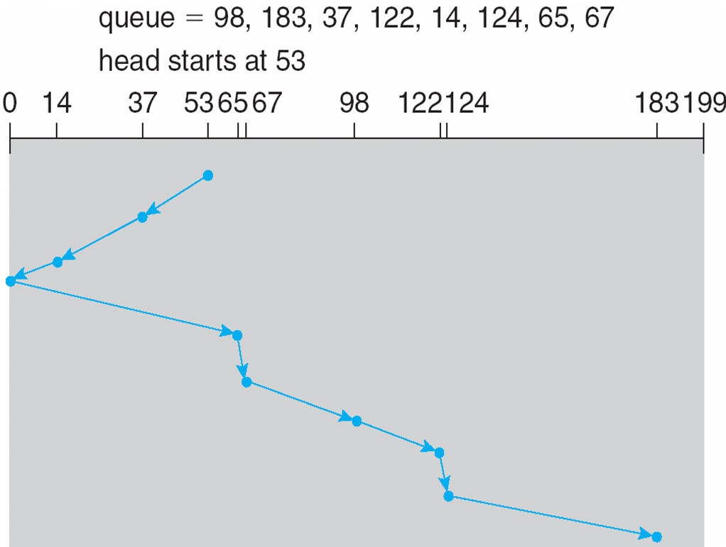
SCAN: Elevator algorithm
The disk arm starts at one end of the disk, and moves toward the other end, servicing requests until it gets to the other end of the disk, where the head movement is reversed and servicing continues.
total head movement : 208 cylinders

Slide 109
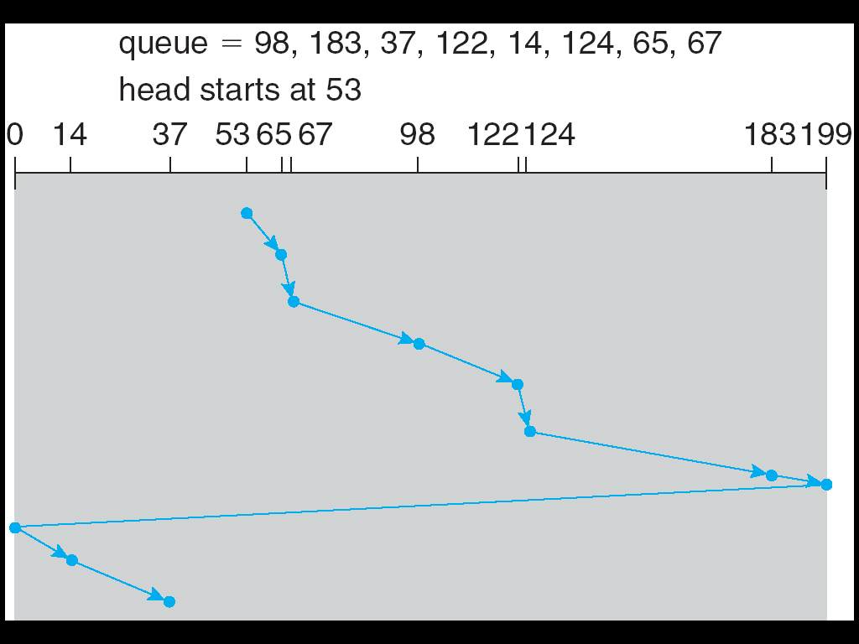
C-SCAN (Circular-SCAN)
Provides a more uniform wait time than SCAN by treating cylinders as a circular list.
The head moves from one end of the disk to the other, servicing requests as it goes. When it reaches the other end, it immediately returns to the beginning of the disk, without servicing any requests on the return trip

Slide 110
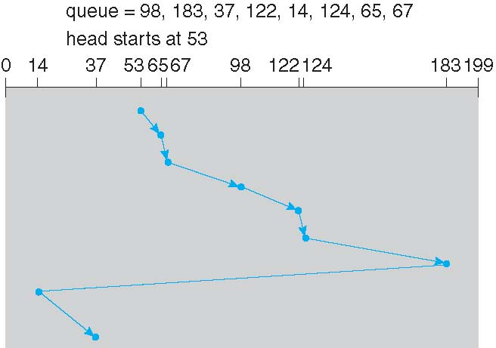
C-LOOK: A version of C-Scan
Arm only goes as far as the last request in each direction, then reverses direction immediately, without first going all the way to the end of the disk

Slide 111
Scheduling Algorithms
Algorithm Name | Description
FCFS | First-come first-served
SSTF | Shortest seek time first; process the request that reduces next seek time
SCAN (aka Elevator) | Move head from end to end (has a current direction)
C-SCAN | Only service requests in one direction (circular SCAN)
LOOK | Similar to SCAN, but donot go all the way to the end of the disk.
C-LOOK | Circular LOOK. Similar to C-SCAN, but donot go all the way to the end of the disk.
Notes:
SCAN (dumb elevator): Back and forth, to end/start track
C-: Circular: Only process requests in one direction
LOOK: Only go as far as last request

Slide 112
Selecting a Disk-Scheduling Algorithm
Either SSTF or C-LOOK is a reasonable choice for the default algorithm
SSTF is common with its natural appeal (but it may lead to starvation issue).
C-LOOK is fair and efficient
SCAN and C-SCAN perform better for systems that place a heavy load on the disk
Performance depends on the number and types of requests

Slide 113
Swap-Space Management
Swap-space — Virtual memory uses disk space as an extension of main memory
Swap-space can be carved out of the normal file system, or, more commonly, it can be in a separate disk partition
Swap-space management
Allocate swap space when process starts; holds text segment (the program) and data segment
Kernel uses swap maps to track swap-space use

Slide 114
Solid state Media
It comes in same shape and size as of HDD
It supports SATA, SAS & FC interface
PCI Card / solid state card , it is solid state media in form of PCI expansion card
It is used in high end storage arrays for as level 2 cache
It has no mechanical parts
It gives excellent performance for random work load
More predictable performance as compared to disk as has no positional latency
Requires less power
It is expensive
For Random reads SSD dives similar performance as DRAM

Slide 115
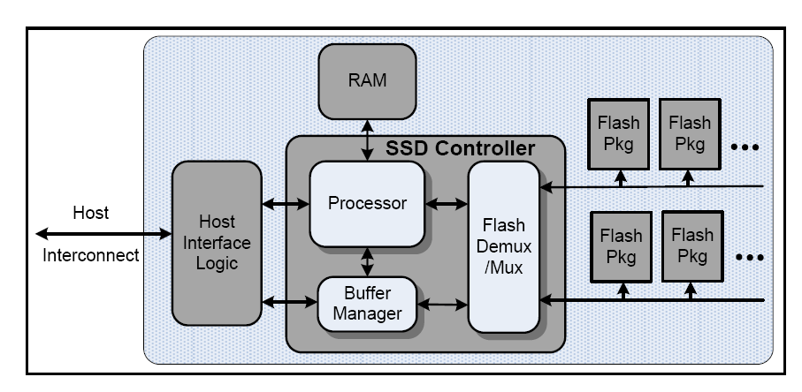
SSD Logic Components

Slide 116
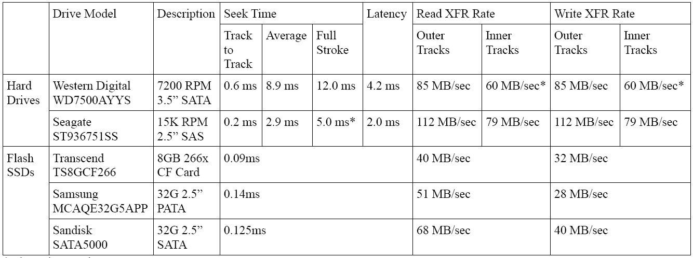
Typical read and write performance

Slide 117
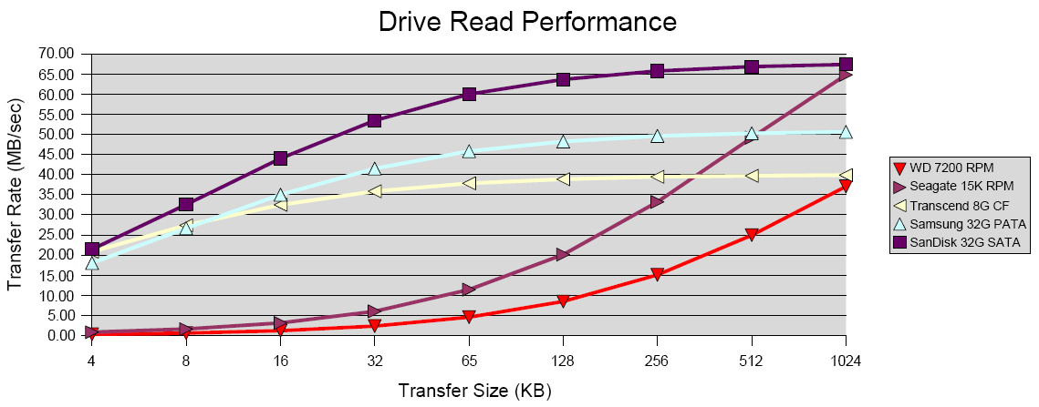
Drive read performance

Slide 118
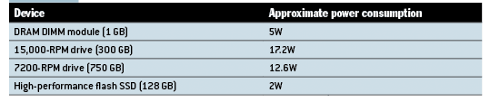
Power consumption

Slide 119
Flash Memory
Two Types
NAND flash ( Most widely used)
Designed with small cell size
Has low cost –per –bit for stored data
Used as high density medium for consumer device
Program erase cycle ( PE cycle ) 100000
NOR Flash
is typically used for storing code and direct execution in portable electronic devices
Nor is typically slow on write and consume more power than NAND
NOR is fast on read and consumes less power

Slide 120
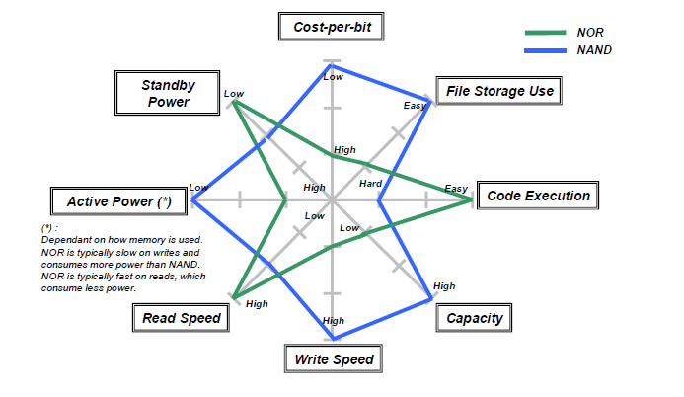
Comparison of NOR & NAND flash

Slide 121
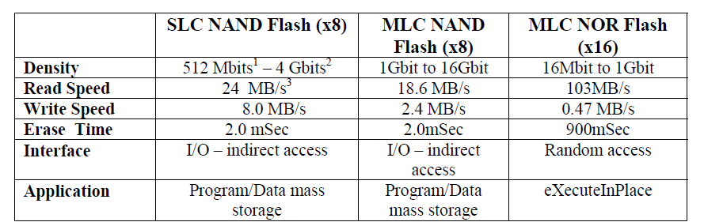

Slide 122
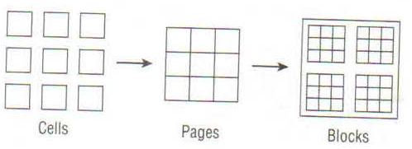
Anatomy of Flash memory
Flash memory is made up of flash cell
Cells are grouped into pages (4K, 8K, 16K etc)
Pages are grouped into blocks (128 K, 256 K 512 K)

Slide 123
Writing to flash memory
New flash comes with all cells set to 1
Flash cells can be programmed from one to zero
To convert to zero to one erase operation is to be performed
Erasing can only be done at block level
First time write performance is very fast
If any part of flash memory block has been written alll subsequent write to any part will take via read –erase – write operation

Slide 124
Types of NAND Flash
Single Level cell (SLC)
can store one bit of data
Highest performance
lowest density
Expensive
Multi level cell
Stores two bit of data per cell
Lower PE cycle 10000
Read about eMLC
It stores 2 bit per cell by applying different level of voltage
Triple Level cell

Slide 125
Garbage Collection
Block that is marked for deletion
Block that are sparsely filled ( can be combined into fewer block )
Write amplification
When number of write to media is greater than number of write issued by host
Write amplification slows flash performance and wears out flash cell
Wear leveling : is process of distributing the work load across all flash cell.
Background wear leveling
In-flight wear leveling

Slide 126
Caching in SSD
It improves performance
Extends the life of media
Write coalescing : is process of holding write in cache , untill page or block can be writen
Write combining : when a particular LBA is written over and over again

Slide 127
Cost of flash & SSD
$/GB cost for Flash is higher than $/GB cost for HDD
$/ I/O Operation
SSD costing $10000 provides 25000 IOPS resulting into $.4/ I/O operation
600GB disk drive costing $ 2000 provides 200 IOPS resulting into $10 / I/O operation
If we need to provide 25000 IOPS, we need 125 drives . These drives will require power, cooling

Slide 128

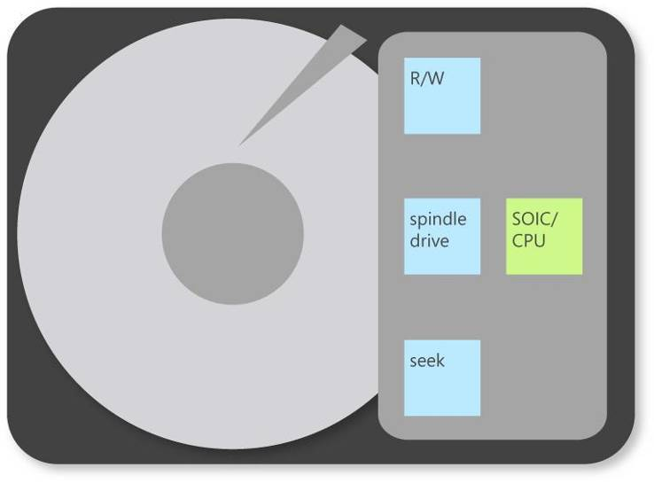
Hybrid Disk Drive
A hybrid disk uses a small SSD as a buffer for a larger drive
All dirty blocks can be flushed to the actual hard drive based on:
Time, Threshold, Loss of power/computer shutdown
Dram
Cache
ATA Interface
Add a non-volatile cache
NV
Cache

Slide 129
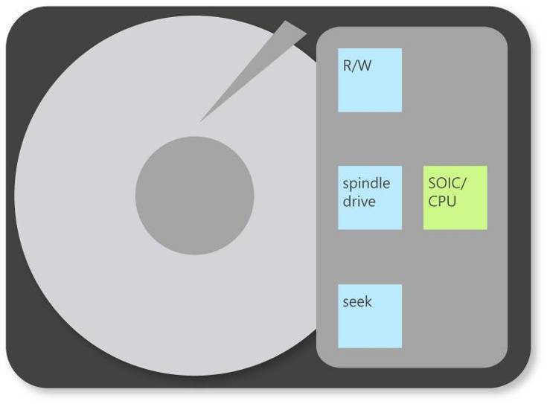
Hybrid Disk Drive Benefits
Dram
Cache
Up to 90% Power Saving
when powered down
ATA Interface
Read and Write instantly while spindle stopped
NV
Cache

Slide 130
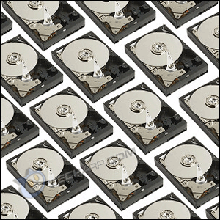
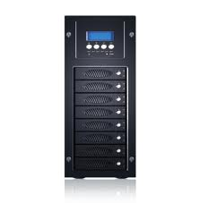
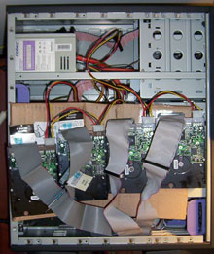
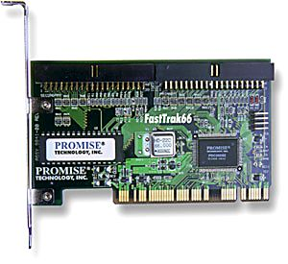
RAID (Redundant Array of Inexpensive Disks)
Multiple disk drives provide reliability
via redundancy.
Increases the mean time to failure
Hardware RAID with RAID controller
vs software RAID

Slide 131
Thank You!

Slide 132
RAID (Redundant Array of Inexpensive Disks)
Multiple disk drives provide reliability via redundancy.
Increases the mean time to failure
Hardware RAID with RAID controller vs software RAID

Slide 133
RAID (Cont.)
RAID
multiple disks work cooperatively
Improve reliability by storing redundant data
Improve performance with disk striping (use a group of disks as one storage unit)
RAID is arranged into six different levels
Mirroring (RAID 1) keeps duplicate of each disk
Striped mirrors (RAID 1+0) or mirrored stripes (RAID 0+1) provides high performance and high reliability
Block interleaved parity (RAID 4, 5, 6) uses much less redundancy

Slide 134
RAID (Cont. )
RAID has two main goal
Increase performance by striping
Distributes data over several hard disk thus distributes the load
Increase fault tolerance by redundancy

Slide 135
Storage Virtualization using RAID
RAID controller combines the Physical hard disk to create Virtual hard disk resulting into larger capacity, & less device address
Server connected to a RAID system sees only Virtual hard disk
Controller can distribute data to physical disk in different manner resulting into different RAID levels
If Physical hard disk fails, RAID controller constructs the data from remaining hard disk
RAID controllers can manage common pool of hot spare for several Virtual RAID disk

Slide 136
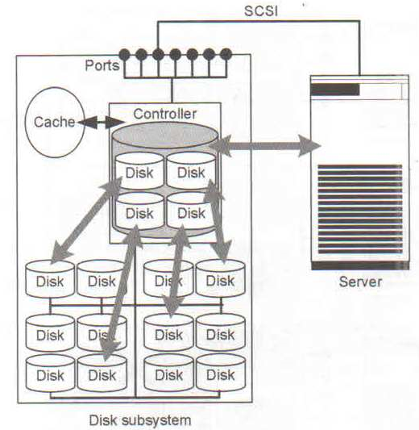

Slide 137
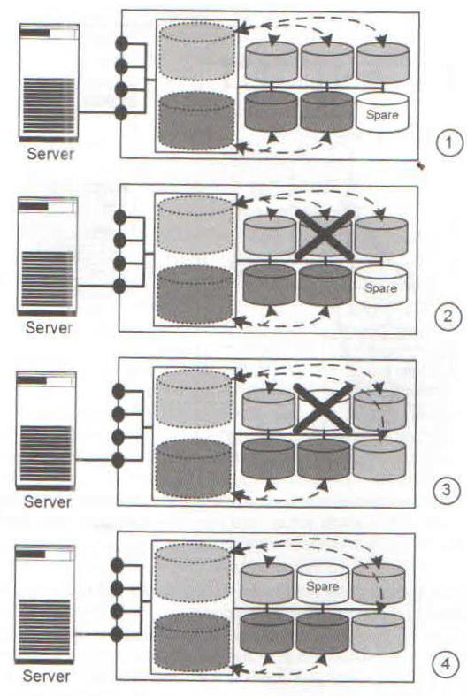

Slide 138
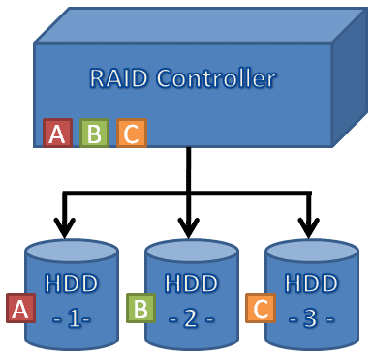
Raid Level 0
Level 0 is non redundant disk array
Block level striping
Files are striped across disks, no redundant info
High read throughput
Best write throughput (no redundant info to write)
Any disk failure results in data loss

Slide 139
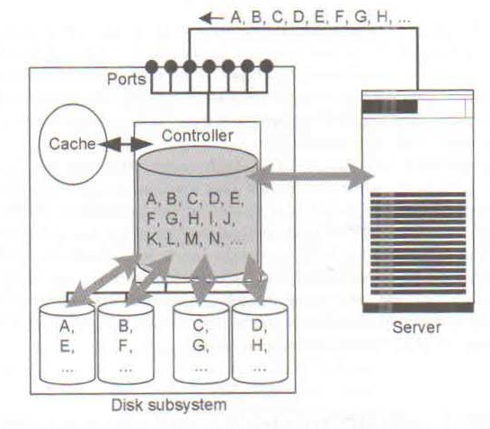
RAID 0

Slide 140
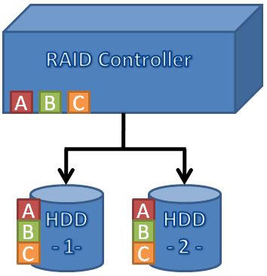
Raid Level 1
Mirrored Disks
Data is written to two places
On failure, just use surviving disk and easy to rebuild
On read, choose fastest to read
Write performance is same as single drive, read performance is 2x better
Expensive (high space overhead)

Slide 141
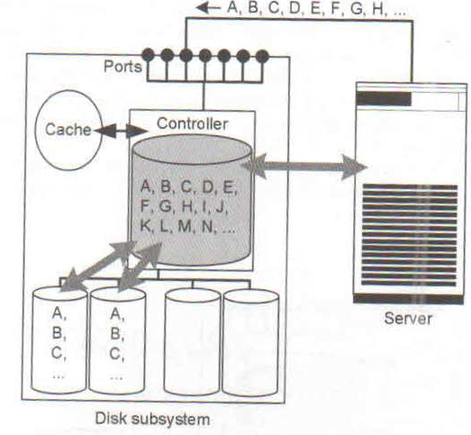

Slide 142
RAID 0+1(Stripping & mirroring) & RAID 1+0 (Mirror & striping )
RAID 0 Increases Performance & RAID 1 increases fault tolerance.
Can We achieve both ?
These Represent Two stage virtualization Hierarchy
In RAID 0+1 stripe & mirror

Slide 143
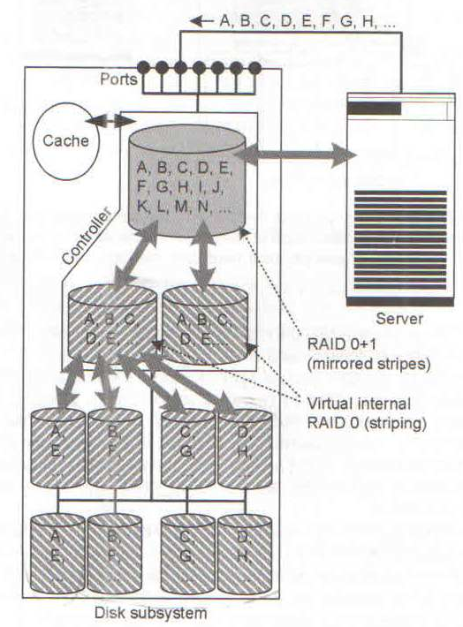

Slide 144
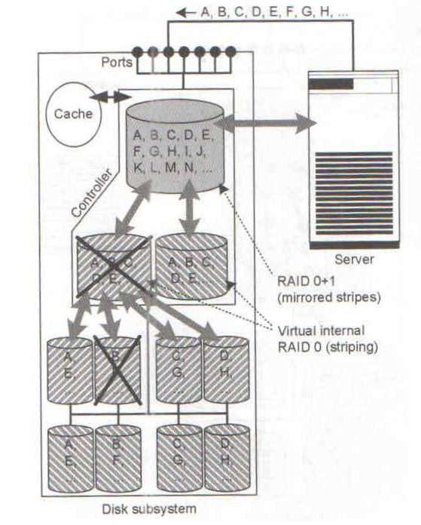

Slide 145
Raid Level 0+1
Stripe on a set of disks
Then mirror of data blocks is striped on the second set.
Stripe 0
Stripe 1
Stripe 2
Stripe 3
Stripe 0
Stripe 1
Stripe 2
Stripe 3
Stripe 4
Stripe 5
Stripe 6
Stripe 7
Stripe 4
Stripe 5
Stripe 6
Stripe 7
Stripe 8
Stripe 9
Stripe 8
Stripe 9
data disks
mirror copies

Slide 146
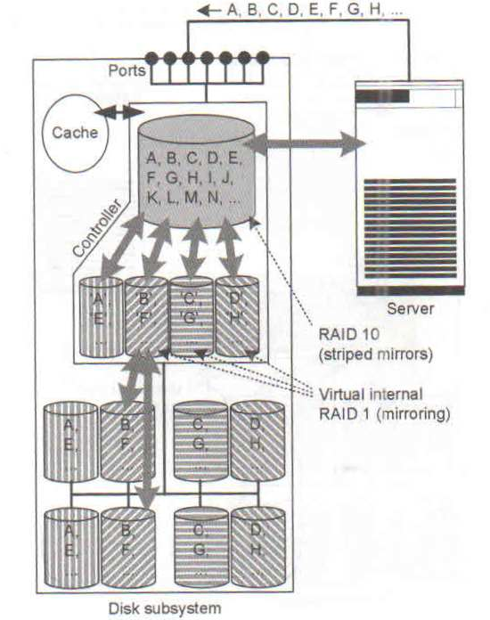
RAID 10

Slide 147
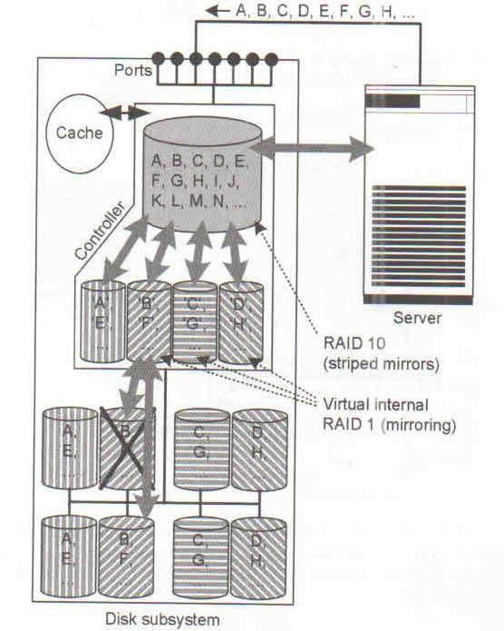

Slide 148
Raid Level 1+0
Pair mirrors first.
Then stripe on a set of paired mirrors
Better reliability than RAID 0+1
Stripe 0
Stripe 0
Stripe 2
Stripe 2
Stripe 4
Stripe 4
Stripe 6
Stripe 6
Stripe 8
Stripe 8
Stripe 10
Stripe 10
Mirror pair
Stripe 1
Stripe 1
Stripe 3
Stripe 3
Stripe 7
Stripe 7
Stripe 5
Stripe 5
Stripe 11
Stripe 11
Stripe 9
Stripe 9

Slide 149
RAID 2, RAID 3
RAID 2 Uses hamming code for error detection & correction
Uses Log (N) + 1 redundant disk
Uses BIT interleaved Parity
Require synchronized disk access
RAID 2 has no longer any practical significance
RAID 3 uses single parity disk
RAID 3 gives high data transfer & low I/O rate
All disks are involved in read & write operation
RAID 3 does not involve any write penalty

Slide 150
RAID 4 & 5
RAID 4 I uses Block interleaved parity
Independent disk access
High data transfer and high I/O rate possible
P = A B C
If Disk A is lost then Find P A and XOR it on both sides of expression
P P A = A A P B C
RAID 4 Has write penalty

Slide 151

RAID 5

Slide 152

6 RAID Levels

Slide 153
Raid Level 0+1
Stripe on a set of disks
Then mirror of data blocks is striped on the second set.
Stripe 0
Stripe 1
Stripe 2
Stripe 3
Stripe 0
Stripe 1
Stripe 2
Stripe 3
Stripe 4
Stripe 5
Stripe 6
Stripe 7
Stripe 4
Stripe 5
Stripe 6
Stripe 7
Stripe 8
Stripe 9
Stripe 8
Stripe 9
data disks
mirror copies

Slide 154
Raid Level 1+0
Pair mirrors first.
Then stripe on a set of paired mirrors
Better reliability than RAID 0+1
Stripe 0
Stripe 0
Stripe 2
Stripe 2
Stripe 4
Stripe 4
Stripe 6
Stripe 6
Stripe 8
Stripe 8
Stripe 10
Stripe 10
Mirror pair
Stripe 1
Stripe 1
Stripe 3
Stripe 3
Stripe 7
Stripe 7
Stripe 5
Stripe 5
Stripe 11
Stripe 11
Stripe 9
Stripe 9

Slide 155
Thank You!

Slide 156

RAID DP

Slide 157

Recovery from failure

Slide 158


Slide 159


Slide 160


Slide 161


Slide 162


Slide 163


Slide 164


Slide 165


Slide 166
Caching
Used by OS to speedup slow operation
In disk subsystems , Caches are designed to accelerate read, write access to physical hard disk
Cache on hard disk
Cache on controller
Read cache
Write cache

Slide 167
Cache on hard disk
Each disk comes with small cache
Transfer rate of I/O channel to disk controller is significantly higher than speed at which disk controller can write to or read from disk
When server / RAID controller writes a block , the disk controller stores it in cache thus freeing the I/O channel
The freed I/O channel can be used for data traffic to other hard disk

Slide 168
Write Cache In controller
The write cache should have a battery backup and ideally be mirrored
Controller buffers all writes into battery backed cache and reports back to app/server write complete
Controller later writes data from cache to slower disk
Read cache is used for pre-fetching

Slide 169
Intelligent disk sub system
These offer additional function over and above RAID eg .
Instant copy
Remote mirroring
LUN masking

Slide 170
Instant copy
Can copy very large data sets within disk subsystem in a few seconds
Instant copies are used for
Generation of test data set
Backup operation
Creating data copies for data mining

Slide 171

Original data
Server 1 works on original data

Slide 172

Copied data
Original data

Slide 173

Copied data
Original data

Slide 174
Implementation Alternative
Data is permanently mirrored
On copy command , mirrors are separated
Separated mirrors can be used independently
After separation of mirror production data is no longer protected against failure
To data protection three way mirror is created

Slide 175
Remote Mirroring
Data copy generated using instant copy does not protect against disk subsystem failure
Remote mirroring provide protection against such failures
Remote mirroring is handled by two participating subsystem
It is invisible to application server
It requires resources in two disk subsystems and I/O channel that connects them

Slide 176


Slide 177


Slide 178
Remote Mirroring
The application server, disk subsystem plus associated data is installed in primary data center
The disk subsystem independently mirrors the application data onto the second disk subsystem
Application data in backup data center is always kept up to date with the time interval for updating second system being configurable
Remote mirroring
Synchronous
Asynchronous

Slide 179

Synchronous remote mirroring
The copy of data held at second disk subsystem is always up-
To date
The response time to server is increased
It is this response time that would determine the application
throughput

Slide 180
Server writes block A to the first disk susbsystem
Disk subsystem stores this in it cache and immediately sends it to second disk subsystem
First disk subsystem waits until second disk subsystem reports back
Increaseed response time
Mirroring over longer distance requires asynchronous mirroring

Slide 181

Asynchronous remote mirroring
No guarantee that mirrored data is up to date

Slide 182

Asynchronous with three disk subsystem

Slide 183
LUN Logical unit number
Disk are installed in disk sub system
A capacity is carved into volume by array
These volumes are presented to host via front end ports as LUN
LUN looks and behaves like locally installed disk

Slide 184

LUN masking
Is a process of controlling which server can see which LUN
It is basically access control

Slide 185
Disk load computation
For an application disk load is computed by considering the type of RAID
Consider an app generating 5200 IOPS with 60% being read
Disk load in RAID 5 is given as:
Disk load = fraction of read * IOPS + fraction of write *4 *IOPS
Disk load = 0.6* 5200 + 0.4 *4*5200= 11440 IOPS
Disk Load for RAID 1
Disk load =0.6*5200+.4*2*5200= 7280
If hdd has max of 180 IOPS then number of disk required for RAID 5 will be
RAID 5 11440/180 = 64
RAID 1 7280/180=42

Slide 186
I/O techniques
I/O path from CPU to storage
Realization of I/O path using SCSI
SCSI defines medium ( Physical Cable)
Communication protocol
Fibre channel
Developed as backbone technology for connection of lAN
Replace the SCSI b cable by network
Server and storage device exchange data using SCSI cammand but data is transmitted via FC network
IP storage

Slide 187
Thank You!

Slide 188
Bus basics & I/O techniques

Slide 189
What is Bus ?
Bus is a set of signals grouped together to perform specific function
Various subsystems must have interfaces to one another eg.
Memory and CPU need to communicate
CPU & I/O need to communicate with each other
Bus serves as shared communication link between the sub systems

Slide 190
Memory
Data Bus
Processor
Control bus
Address Bus
I/O
I/O

Slide 191
Advantages of BUS
Low cost & versatility
By defining single interconnection scheme, new devices can be easily added
Peripherals can be moved between computer system that use common bus
Cost is low as single set of wires is shared among multiple devices
Bus standardization has led to
Standard I/O communication
Modular system design

Slide 192
Disadvantage of Bus
Bus creates a communication bottleneck
Bus puts a maximum Limit on the I/O throughput

Slide 193
Bus design Challenges
In general I/O devices are much slower as compared to CPU
A computing system may have several different type of I/O devices having
Different Data transfer speed
Different data Bus width
Maximum Bus speed is limited by physical factors
Length of bus
Number of devices connected to bus (Bus Loading)
Physical limits prevents arbitrary bus speedup
High I/O rate and high data transfer rate put conflicting design requirement

Slide 194
Buses were traditionally classified as CPU- Memory Bus and I/O Bus
CPU -Memory Bus
It is short
It is High Speed
Matched to Memory system to maximize memory-CPU bandwidth
Designing a CPU-memory bus is easier as all memory devices in the system have to have similar characteristics as opposed to I/O devices
I/O Bus
May be long
May have many types of devices
Bus designer has to take care of varying latency and bandwidth requirement of I/O devices

Slide 195
Some systems use a single bus for both memory and I/O and some have hybrid bus eg. PCI
PCI bus uses Bridge to connect to traditional I/O Bus
Bridge understands both PCI and I/O bus protocol

Slide 196
CPU Memory Bus
Cache
Bus Adapter
Bus Adapter
Main Memory
CPU
AGP Bus
PCI Bus
I/O Controller
Bus Adapter
I/O Controller
I/O Bus
Network
Graphical
Output
I/O Controller
I/O Controller
Disk
Disk
CD

Slide 197
Options for Bus
Bus width
Separate address and data lines
Multiplexed address and data lines
Data width
Wide (64 Bit)
Narrow (8 bit)
Transfer size: Multiple word Vs single word
Bus master
Multiple ( Require bus arbitration)
Single master (No arbitration)
Clocking : Synchronous Vs Asynchronous
Parallel bus Vs serial bus

Slide 198
I/O techniques
I/O path from CPU to storage
Realization of I/O path using SCSI
SCSI defines medium ( Physical Cable)
Communication protocol
Fibre channel
Developed as backbone technology for connection of LAN
Replace the SCSI cable by network
Server and storage device exchange data using SCSI command but data is transmitted via FC network
IP storage

Slide 199

I/O path from CPU to storage

Slide 200
Physical I/O path from CPU to storage consists of
System Bus:
ensures rapid transfer of data between CPU & main memory
Bus length is kept as short as possible
Connects only CPU and memory
Host I/O Bus
Peripheral component interconnect (PCI) Is most popular technology for host I/O Bus
Bridge communication chip provides connection between system bus and Host I/O bus
Infiniband could replace PCI
I/O bus :Important technologies Are
SCSI (small Computer system Interface)
FC

Slide 201


Slide 202
SCSI : introduction
Developed by Shugart Associates & named as SASI (Shugart Associates System Interface)
ANSI acknowledged SCSI as an industry standard
SCSI versions
SCSI–1 : Introduced in 1986
Defined cable length, signaling characteristics, commands & transfer modes
Used 8-bit narrow bus with maximum data transfer rate of 5 MB/s
SCSI–2
Defined Common Command Set (CCS) to address non-standard implementation of the original SCSI
Improved performance, reliability, and added additional features
SCSI–3
Latest version of SCSI
Comprised different but related standards, rather than one large document

Slide 203

SCSI
SCSI Defines a parallel Bus for transmission of data with additional lines for control
Can be realized in form of printed conductor on circuit board or as a cable
Daisy chain can connect up to 16 devices

Slide 204


Slide 205
SCSI–3 Architecture
SCSI Architectural Model
SCSI-3 Command Protocol
SCSI Primary
SCSI Specific
Commands
Commands
Common
Transport Layer
Access
SCSI-3
Fibre Channel
Serial Bus
Generic
Method
Protocol
Protocol
Protocol
Packetized
Protocol
Physical Layer
SCSI-3
IEEE
Fibre
Parallel
Serial Bus
Channel
Interface
SCSI command protocol
Primary commands common to all devices
Transport layer protocol
Standard rules for device communication and information sharing
Physical layer interconnect
Interface details such as electrical signaling methods and data transfer modes

Slide 206
SCSI Device Model
SCSI communication involves:
SCSI initiator device
Issues commands to SCSI target devices
Example: SCSI host adaptor
SCSI target device
Executes commands issued by initiators
Examples: SCSI peripheral devices
SCSI
SCSI
Initiator Device
Target Device
Device Service
Request
Logical Unit
Device Service
Device
Response
Server
Application
Client
Task Management
Request
Task
Manager
Task Management
Response

Slide 207
SCSI Device Model (Cont.)
Device requests uses Command Descriptor Block (CDB)
8 bit structure
Contain operation code, command specific parameter and control parameter
SCSI Ports
SCSI device may contain initiator port, target port, target/initiator port
Based on the port combination, a SCSI device can be classified as an initiator model, a target model, a target model with multiple ports or a combined model (target/initiator model). Example:
Target/initiator device contain target/initiator port and can switch orientations depending on the role it plays while participating in an I/O operation
To cater to service requests from multiple devices, a SCSI device may also have multiple ports (e.g. target model with multiple ports)

Slide 208

SCSI
The protocol Introduces SCSI ID ( target ID) & Logical Unit Number for addressing the deices
Each device must have unique ID
Host bus adapter will also have ID
The priority of SCSI ID 7 has highest priority

Slide 209


SCSI Addressing
Initiator
LUNs
Target
Initiator ID
Target ID
LUN
Initiator ID - a number from 0 to 15 with the
Target ID - a number from 0 to 15
LUN - a number that specifies a device addressable through a target.

Slide 210


Slide 211

SCSI Addressing Example
Target (Front-end port)
Target – t0
d0
Port
LUN
Storage Volumes
Port
LUN
d1
Port
LUN
d2
Port
Port
Host
Initiator (HBA)
Controller – c0
Storage Array
Host Addressing:
Storage Volume 1 - c0t0d0 Storage Volume 2 - c0t0d1 Storage Volume 3 - c0t0d2
Initiator ID
Target ID
LUN
c0
t0
d0

Slide 212

SCSI & Storage Network
In twin tailed SCSI cabling only one server is active

Slide 213

SCSI SAN

Slide 214
SCSI SAN
Can be built using multi port storage system
Length restriction of SCSI puts constraint
Difficult to administer
Link extender can be used for extending the bus length

Slide 215
FC
Is a communication protocol designed to achieve following goals
Allowing many well-known existing channel and networking protocols to run over the same physical interface and media
High bandwidth (100MB/s and beyond
Flexible topologies
Connectivity over several kilometers
Support for multiple data rates, media types, and connectors
Features of FC
Serial transmission
low rate transmission error
Low latency
Implementation of FC in hardware

Slide 216
Thank You!

Slide 217
I/O techniques
I/O path from CPU to storage
Realization of I/O path using SCSI
SCSI defines medium ( Physical Cable)
Communication protocol
Fibre channel
Developed as backbone technology for connection of lAN
Replace the SCSI b cable by network
Server and storage device exchange data using SCSI cammand but data is transmitted via FC network
IP storage

Slide 218
I/O path from CPU to storage

Slide 219
Physical I/O path from CPU to storage consists of
System Bus:
ensures rapid transfer of data between CPU & main memory
Bus length is kept as short as possible
Connects only CPU and memory
Host I/O Bus
Peripheral component interconnect (pci ) Is most popular technology for host I/O Bus
Bridge communication chip provides connection between system bus and Host I/O bus
Infiniband could replace PCI
I/o bus :Important technologies Are
SCSI,
FC

Slide 221
SCSI : introduction
Developed by Shugart Associates & named as SASI (Shugart Associates System Interface)
ANSI acknowledged SCSI as an industry standard
SCSI versions
SCSI–1 : Introduced in 1986
Defined cable length, signaling characteristics, commands & transfer modes
Used 8-bit narrow bus with maximum data transfer rate of 5 MB/s
SCSI–2
Defined Common Command Set (CCS) to address non-standard implementation of the original SCSI
Improved performance, reliability, and added additional features
SCSI–3
Latest version of SCSI
Comprised different but related standards, rather than one large document

Slide 222
SCSI
SCSI Defines a parallel Bus for transmission of data with additional lines for control
Can be realized in form of printed conductor on circuit board or as a cable
Daisy chain can connect up to 16 devices

Slide 224
SCSI–3 Architecture
SCSI Architectural Model
SCSI-3 Command Protocol
SCSI Primary
SCSI Specific
Commands
Commands
Common
Transport Layer
Access
SCSI-3
Fibre Channel
Serial Bus
Generic
Method
Protocol
Protocol
Protocol
Packetized
Protocol
Physical Layer
SCSI-3
IEEE
Fibre
Parallel
Serial Bus
Channel
Interface
SCSI command protocol
Primary commands common to all devices
Transport layer protocol
Standard rules for device communication and information sharing
Physical layer interconnect
Interface details such as electrical signaling methods and data transfer modes

Slide 225
SCSI Device Model
SCSI communication involves:
SCSI initiator device
Issues commands to SCSI target devices
Example: SCSI host adaptor
SCSI target device
Executes commands issued by initiators
Examples: SCSI peripheral devices
SCSI
SCSI
Initiator Device
Target Device
Device Service
Request
Logical Unit
Device Service
Device
Response
Server
Application
Client
Task Management
Request
Task
Manager
Task Management
Response

Slide 226
SCSI Device Model (Cont.)
Device requests uses Command Descriptor Block (CDB)
8 bit structure
Contain operation code, command specific parameter and control parameter
SCSI Ports
SCSI device may contain initiator port, target port, target/initiator port
Based on the port combination, a SCSI device can be classified as an initiator model, a target model, a target model with multiple ports or a combined model (target/initiator model). Example:
Target/initiator device contain target/initiator port and can switch orientations depending on the role it plays while participating in an I/O operation
To cater to service requests from multiple devices, a SCSI device may also have multiple ports (e.g. target model with multiple ports)

Slide 227
SCSI
The protocol Introduces SCSI ID ( target ID) & Logical Unit Number for addressing the deices
Each device must have unique ID
Host bus adapter will also have ID
The priority of SCSI ID 7 has highest priority

Slide 228
SCSI Addressing
Initiator
LUNs
Target
Initiator ID
Target ID
LUN
Initiator ID - a number from 0 to 15 with the
Target ID - a number from 0 to 15
LUN - a number that specifies a device addressable through a target.

Slide 230
SCSI Addressing Example
Target (Front-end port)
Target – t0
d0
Port
LUN
Storage Volumes
Port
LUN
d1
Port
LUN
d2
Port
Port
Host
Initiator (HBA)
Controller – c0
Storage Array
Host Addressing:
Storage Volume 1 - c0t0d0 Storage Volume 2 - c0t0d1 Storage Volume 3 - c0t0d2
Initiator ID
Target ID
LUN
c0
t0
d0

Slide 231
SCSI & Storage Network
In twin tailed SCSI cabling only one server is active

Slide 232
SCSI SAN

Slide 233
SCSI SAN
Can be built using multi port storage system
Length restriction of SCSI puts constraint
Difficult to administer
Link extender can be used for extending the bus length

Slide 234
Fiber Channel
Is a communication protocol
Originally developed as backbone technology for connecting LANs.
The original development objective was to support
Fast Ethernet (100 Mbps )
Fiber distributed data interface (FDDI)
Allowing many well-known existing channel and networking protocols to run over the same physical interface and media
High bandwidth (100MB/s and beyond

Slide 235
Fiber Channel
Flexible topologies
Connectivity over several kilometers
Support for multiple data rates, media types, and connectors
Features of FC
Serial transmission
low rate transmission error
Low latency
Implementation of FC in hardware on HBA card to free up the server CPU
Notes:
In early 1990s, Seagate was looking for alternate technology to IBM’S Serial storage architecture . With support of Fibre channel industry FC was expanded by the arbitrated loop topology which is cheaper than originally developed fabric topology. This led to a breakthrough of Fibre channel for realization of storage network

Slide 236
What is Channel ?
channel is a closed, direct, structured, and predictable mechanism for transmitting data between relatively few entities.
It provides a direct or switched point-to-point connection between the communicating devices.
once a channel is set up, there is very little decision making needed enabling hardware-intensive environment and transports data at the high speed with low overhead.
Channels are commonly used to connect peripheral devices such as a disk drive, printer, tape drive, etc. to a workstation.
Common channel protocols are Small Computer System Interface (SCSI) and High Performance Parallel Interface (HIPPI).

Slide 237
Network
Networks are aggregations of distributed nodes(like workstations, file servers or peripherals) with there own protocol that support interaction among these nodes.
Networks are unstructured and unpredictable
Networks are able to automatically adjust to changing environments and can support a larger number of connected nodes.
Require decision making in order to successfully route data from one point to another.
Networks have relatively high overhead since they are software-intensive
networks inherently slower than channels.
Examples of common networks are Ethernet, Token Ring, and Fiber Distributed Data Interface (FDDI)

Slide 238
Network
OSI ( Open Standard Interconnect ) Model Has seven layers
Physical, Data Link, Network, Transport, Session, Presentation, and Application.
Fibre Channel does not follow this model, the protocol has been broken into five layers
FC-0, FC-1, FC-2, FC-3, and FC-4
FC-0 to FC-2 contains the physical description of Fibre Channel defined in the FC-PH
FC-3 and FC-4 describe the interface with other applications

Slide 239
Fibre Channel : FC 0
Defines the physical media used to link two Fibre Channel ports. This includes
Types of cabling
Optical & electrical parameters, data rate , maximum transfer distance, noise limits etc
Fibre Channel supports two types of cables:
Copper :used for interconnecting storage devices over short distances
Optical ( Single Mode , Multimode )
Each link must connect two Fibre Channel ports, a transmitting port at one end and a receiving port at the other end.

Slide 240
Fibre Channel : FC 1
FC-1 defines the transmission protocol
serial encoding and decoding rules ( 8b/10b or 64b/66b ), special character & error control
The information transmitted over a fiber is encoded 8 bits at a time into a 10 bit Transmission Character
The layer also controls the media access, defining the receiving and transmitting ports and there operations.

Slide 241
Fibre Channel : FC 2
serves as the transport mechanism of Fibre Channel
mechanisms for controlling the three service classes
The layer defines most of the Fiber Channel specific :flow control, encapsulation of data into frames and sequence exchanges.
provides Fiber Channel classes of service information
The layer also defines the physical models for the Fibre Channel components, including the definition of nodes, ports, segmentation and reassembly, Login/Logout and Fibre Channel topologies.

Slide 242
Fibre Channel : FC 3
FC-3 layer is intended to provide the common services required for advanced features such as:
Hunt groups-The ability for more than one Port to respond to the same alias address
Striping-To multiply bandwidth

Slide 243
Fibre Channel : FC 4
FC-4 defines the application interfaces that can execute over Fibre Channel
It specifies the mapping of upper layer protocols using the FC levels below
Fibre Channel can transporting both network and channel information and allows both protocol types to be concurrently transported over the same physical interface
The following network and channel Upper Layer Protocols (ULP) mapping are currently specified or proposed as FC-4s.
Small Computer System Interface (SCSI)
Internet Protocol (IP)
High Performance Parallel Interface (HIPPI)Framing Protocol
Link Encapsulation (FC-LE)
IEEE 802.2
Asynchronous Transfer Mode - Adaption Layer 5 (ATM-AAL5)
Intelligent Peripheral Interface - 3 (IPI-3) (disk and tape)
Single Byte Command Code Sets (SBCCS)

Slide 244


Slide 246
Advantage of Fibre Channel
Multiple Topologies - Dedicated point-to-point, shared loops, and scaled switched topologies
Multiple Protocols - Fibre Channel delivers data. SCSI, TCP/IP, video, or raw data can all take advantage of high performance, reliable Fibre Channel technology
Scalable - From single point-to-point gigabit links to integrated enterprises with hundreds of servers, Fibre Channel delivers unmatched performance
Congestion Free - Fibre Channel's credit-based flow control delivers data as fast as the destination buffer is able to receive it.

Slide 247

Fibre channel : terminology
Node :
A device that attaches to fibre channel
It may be a workstation, disk drive , tape drive or even a phone
Ports : Each node has at least one port to provide access to the node
Link:
Link is made up of two fibres connected to receive and transmit . The pair of fibre is called link

Slide 248

FC 0 Path

Slide 249

FC 0 transmitter interface

Slide 250

FC 0 Receiver interface

Slide 251

Data flow stages

Slide 252
Fibre channel : topology
FC standard define three topology
Point to point
Arbitrated loop
Fabric

Slide 253
Point to point topology
It consists of two and only two Fibre Channel devices connected directly together
The transmit fibre of one device goes to the receive fibre of the other device, and vice versa
There is no sharing of the media, which allows the devices to enjoy the total bandwidth of the link
A simple link initialization is required of the two devices before communication can begin.
Point to point communication occurs between two N ports without use of fabric
Ports must be connected with same media type and speed

Slide 254

Arbitrated loop

Slide 255
Arbitrated loop
Permits connection of up to 127 ports
Shared bandwidth
Uses NL port to interconnect
Data flow is in one direction in the loop
Each port sees all messages and transmit those which is not addressed to it
Only two ports can communicate at one given point of time
When the current pair release the port , another pair may gain control through arbitration
To gain control of loop A device transmits ARBx frame ( X is arbitrated loop Physical address)
Once device receives it own ARBx it gains control and it transmits open primitive signal

Slide 256
Gaining loop control
To gain control of loop, A device transmits ARBx frame ( X is arbitrated loop Physical address)
Once device receives it own ARBx it gains control and it transmits open (OPN) primitive signal to a destination device
If more than one device on the Loop is arbitrating at the same time, the x values of the ARB Primitive Signals are compared
When an arbitrating device receives another device's ARBx, the ARBx with the numerically lower AL_PA is forwarded
ARBx with the numerically higher AL_PA is blocked
The device with the lower AL_PA gains control of the Loop first
AL-PA is dynamically assigned
Starvation may occur
Access Fairness Algorithm :prohibits a device from arbitrating again until all other devices have had a chance to arbitrate

Slide 257
LOOP initialization
Before the Loop is usable, it must be initialized so that each port obtains an Arbitrated Loop Physical Address dyanimically
Arbitrated Loop Physical Address (AL_PA), maps to the lowest byte of Native address Identifier ( 24 Bit )
Although the AL_PA is a byte, only 127 values are valid (neutral running disparity).
If more than 127 devices are present on the Loop, some will not be able to select an AL_PA and will be forced into non-participating mode

Slide 258
Running disparity (RD or rd) is the difference between the number of logic 1 bits and logic 0 bits between the start of a data sequence and a particular instant in time during its transmission.
The RD for a character is the difference between the number of 1 bits and 0 bits in that character. If there are more 1 bits than 0 bits, the RD is defined as positive. If there are fewer 1 bits than 0 bits, the RD is defined as negative. If the number of 1 bits and 0 bits is the same, the RD is defined as neutral or zero.

Slide 259
LOOP initialization
Step1 : The LIP Primitive Sequence begins the process
LIP is transmitted by an L_Port after it powers on, or when it detects Loop Failure
The LIP will propagate around the Loop, triggering all other L_Ports to transmit LIP
At this point, the Loop is not usable.
Step 2: select a Loop master
This is done by transmitting Loop Initialization Select Master (LISM) frames.
The process is designed so that if a Fabric is present, it will become Loop master
otherwise, the port with the numerically lowest Port Name will win

Slide 260
LOOP initialization
Step 3: Allow the L_Ports to select an AL_PA
The 127 bit n AL_PA bitmap is used, where each L_Port selects (and sets) a single bit in the bitmap of a frame originated by the Loop master and repeats the frame back on the Loop
This process is done using four frames, breaking the selection down according to priority
Frame | reason | priority / order transmitted
LIFA Loop Initialization Fabric Assigned | a certain AL_PA was assigned by the Fabric | 1
LIPA Loop Initialization Previously Acquired | before this initialization, the L_Port had a valid AL_PA | 2
LIHA Loop Initialization Hard Assigned | the L_Port has a certain AL_PA it tries to claim | 3
LISA Loop Initialization Soft Assigned | the L_Port claims the first available AL_PA that is left | 4

Slide 261
LOOP initialization
Once the LISA frame has come back to the Loop master, all L_Ports must have selected an AL_PA
Two additional frames may be sent by the Loop master,
Loop Initialization Report Position (LIRP)
As the frame traverses the Loop, each port adds its AL_PA to the end of a list.
When done, the relative positions of all L_Ports is known
Loop Initialization Loop Position (LILP) frame is transmitted, which simply allows all L_Ports to look at the finished list
Loop master transmits the CLS Primitive Signal to let each port know that the process has finished

Slide 262
Fibre Channel Switched Fabric
the fabric is one or more fabric switches connected in a single, sometimes extended, configuration.
provides full bandwidth per port compared to FC-AL where bandwidth is shared
The Fabric topology can be is used to connect as many as 2²⁴ devices in a cross-point switched configuration
many devices can communicate at the same time
When the N_Ports log into the Fabric, the Fabric will assign Native Address Identifiers (S_ID)

Slide 263

Fibre Channel Switched topology

Slide 264
Fabric Elements
N Ports
Arbitrated Loop
Port Types
F , FL, E, GL
When fabric elements are connected usinf E, G, GL Port form the part of same fabric

Slide 265
Types of Port
N_port is a port on the node
L_ port : Loop capable port
F Port : Fabric Port connects to n port
E_Port : used for connecting two switches ( expansion Port)
NL_Port is a port on the node used with an FC-AL topology
FL_port is a port on the switch that connects to a FC-AL loop
G_port or generic port , that can act as an E_port or F_port
GL_port on a switch can operate as an E_port, FL_port, or F_port

Slide 266

Port Summary

Slide 267
Port summary
Ports Perform self discovery at initialization
N Port connected to N or NL Port Operate In P2P topology
Two connected NL port Operate in AL topology
All port support P2P topology by default
A connection of NL with no active FL port is called Private loop
Each N or NL port must login with other port for their communication

Slide 268
Extending a switch fabric
One way to expand the fabric is to cascade switches.
Cascading is interconnecting Fibre Channel switches using ISL
Cascading offers following benefits to a SAN environment
The fabric can be seamlessly extended

Slide 269

Nomenclature for describing FC-0 plant options

Slide 270
FC -1 functionality
Data encoding and transmission
8/10 bit encode/decode scheme
The scheme was developed by IBM
The encoding scheme ensures that the resulting word has no more than 6 total of one type (either 1 or 0) and that no more than 4 of any one type appear in a row
There is a special case where there are 2 characters of one type followed by 5 characters of the opposite type known as the “comma”
All data transmitted through a Fibre Channel network are sent as 10 bit chunks known as Transmission Characters

Slide 271
Transmission character
A TC is composed of a 6 bit subgroup and a 4 bit subgroup
The running disparity is computed on a per-subgroup basis
Transmission Characters (TC) come in two flavors
Data Characters (DC)
Special Characters (SC)
SCs, used for control, are distinguished from DCs via a special indicator known as the control variable

Slide 272
TC representation
The notation format of a TC is Zxx.y
where Z is the control variable can Be either D Or K
xx is the decimal value of the binary number composed of the bits E, D, C, B and A
The y is composed of the remaining 3 bits, H, G and F.

Slide 273

Byte notation: 0xBC -- Special Character

Slide 274

10 Bit encoded value

Slide 275
A good resource for 8B/10 B
https://www.youtube.com/watch?v=B6JRJ3ax3mc

Slide 276
Transmission
Detection of valid characters begins in FC-0
hardware detects an incoming K28.5 (comma) a special character
This character only appears at the beginning of an Ordered Set
A TW is a set of 4 TCs.
Ordered Sets allow the FC-1 level to distinguish data from control information
The type of control information is designated by the 3 TCs directly following a K28.5

Slide 277
The Ordered Sets are four byte transmission words (TW) containing data and special characters which have a special meaning
An Ordered Set always begins with the special character K28.5.
The type of control information is designated by the 3 TCs directly following a K28.5
Three major types of Ordered Sets are defined by the signaling protocol

Slide 278
Three types of ordered set
Frame Delimiters : Frame delimiters mark the beginning and end of frames and are used to specify the class of connection as well
Start-of-Frame (SOF)
End-of-Frame (EOF)
Primitive Signals are used to indicate the Idle condition (maintain link when no data is flowing) and Receiver Ready (low level flow control)
Primitive Sequences :relay the state of FC ports such as Not Operational (NOS), Off-line (OLS), Link Reset (LR) and Link Response (LRR).
Error detection at the FC-1 layer occurs during decoding
two types of errors that can occur.
The first is when 10 bits cannot be found in the encoding tables (invalid TC )
The second type of error is when a valid TC is received, yet it was not the TC that was transmitted

Slide 279
Offline state (OLS)
The offline primitive sequence is transmitted by a port to indicate one of the following conditions:
The port is beginning the link initialization protocol.
The port received and recognized the NOS protocol.
The port is entering the offline status.

Slide 280
Not operational (NOS)
The not operational primitive sequence is transmitted by a port in a point-to-point or fabric environment to indicate that the transmitting port detected a link failure
NOS might indicate an offline condition that is waiting for the OLS sequence to be received.

Slide 281
FC 2 Layer
encapsulation of data using frames
flow control and classes of service
FC-2 provides error control
Frames are the basic package used to encapsulate and transport the data
two basic types of frames,
Data Frame
Link Control Frame
Acknowledge (ACK)
Link_Response (Busy and Reject) frames
A frame is composed of 6 basic sections

Slide 282
Framing rules
The following rules apply to the framing protocol:
A frame is the smallest unit of information transfer.
A sequence has at least one frame.
An exchange has at least one sequence.

Slide 283


Slide 284
The first section is the Start of Frame (SOF).
The SOF is comprised of 4 bytes, the “comma” and 3 bytes indicating the type of connection service.
Next is the Frame Header (FH). The FH contains information to
control link operations,
perform routing,
do protocol processing
detect missing or out of order Frame
major functions of the FH is to uniquely identify active Frames.
Frame is uniquely identified by a combination of the following fields: S_ID, D_ID, OX_ID RX_ID, SEQ_ID and SEQ_CNT

Slide 285
Frame header Field Description
R_CTL: Routing Control - used for categorizing the Frame’s function
D_ID: Destination Identifier - address identifier of the Frame’s destination port
S_ID: Source Identifier - address identifier of the Frame’s source port
TYPE: Data structure type - categorization of the Frame’s data
F_CTL: Frame Control - control information on Frame handling
SEQ_ID: Sequence Identifier - unique identifier for the Frame’s Sequence
DF_CTL: Opt. headers in data field - indication of optional header inclusion
SEQ_CNT: Sequence count - number of the Frame within its Sequence or Exchange
OX_ID: Originator Exchange ID - identification of Frame’s Exchange at Originator
RX_ID: Responder Exchange ID - identification of Frame’s Exchange at Responder

Slide 286
Optional header
The Optional Header section can contain up to 4 types of headers.
Expiration Security Header (how long until Frame should be discarded),
Network Header (contains info pertaining to network related ULPs e.g. IP),
Association Header (associates Frames with different Exchange Id’s)
Device Header (contains other ULP info e.g. SCSI).

Slide 287
Payload
For a Data Frame, the payload contains the user Data.
For a Link Control Frame, the payload is not used
CRC
The CRC field is used to verify the data integrity of the FH and Payload .

Slide 288
EOF
Finally, the End of Frame (EOF) delimiter is an ordered set that designates the end of the Frame content
Additionally the EOF contains information about
the validity of the Frame’s content,
whether to keep the connection open or normally close and if necessary, abort the connection.

Slide 289
Sequence
One logical level up from the Frame is the Sequence
A Sequence is composed of a group of related Frames transmitted in one direction
All frames must be part of a Sequence
Each Frame within a sequence is uniquely numbered with a Sequence Count
Frames within the same Sequence have the same SEQ_ID field in the header
The SEQ_CNT field identifies individual frames within a Sequence

Slide 290
Sequence (cont…)
For each frame transmitted in a Sequence, SEQ_CNT is incremented by 1.
This provides a means for the recipient to arrange the frames in the order in which they were transmitted
Error recovery, controlled by an upper protocol layer is usually performed at Sequence boundaries and to verify that all expected frames have been received

Slide 291
Exchange
An Exchange is composed of one or more nonconcurrent sequences for a single operation Between two ports
The Exchanges may be unidirectional or bidirectional between two N_Ports
All Sequences (and therefore all frames) must be part of an Exchange
Within a single Exchange, only one sequence may be active at any one time
but Sequences of different Exchanges may be concurrently active
The originator of the Exchange assigns the OX_ID field. The responder assigns the RX_ID field.
frame ~ word sequence ~ sentence exchange ~ conversation

Slide 292
FC-3 Common services
Hunt groups
is a set of associated node ports (N_ports) that is attached to a single node. This set is assigned an alias identifier that allows any frames that contain the alias to be routed to any available N_port within the set. This process decreases the latency in waiting for an N_port to become available.
Striping
Striping is used to multiply bandwidth by using multiple N_ports in parallel to transmit a single information unit across multiple links.
Multicast: delivers a single transmission to multiple destination ports. This method includes the ability to broadcast to all nodes or a subset of nodes.

Slide 293
Class 1 service
Dedicated Connection
Once established, a Dedicated Connection is retained and guaranteed by the Fabric.
This service guarantees maximum bandwidth available between Two N ports across the established connection
frames are delivered to the destination N_Port by the Fabric in the same order as they are transmitted by the source N_Port
If theFabric is not present, this service becomes a special case of point-to-point.
21

Slide 294
Class 2 service
Multiplex
is a Connectionless service
Fabric multiplexes frames at frame boundaries
Fabric may not guarantee the order of delivery
The Fabric guarantees notification of delivery or failure to deliver in the absence of link errors

Slide 295
Class 3 service
Datagram
is a Connectionless service with the Fabric multiplexing frames at frame boundaries
Class 3 supports only unacknowledged delivery

Slide 296
Flow Control
Data is sent in frames and devices need to temporarily store the frames as they arrive
The data frames must be stored until they are assembled in sequence and then delivered to the upper-layer protocol
The ability of a device to accept a frame is called its credit.
This credit is typically referred to as the number of buffers (its buffer credit) that a node maintains for accepting incoming data.

Slide 297
Flow control
Buffer to buffer
This type of flow control deals only with the link between an N_Port and an F_Port or between two N_Ports
Both ports on the link exchange values of how many frames it is willing to receive at a time from the other port. This value becomes the other port's BB_Credit value and remains constant as long as the ports are logged in

Slide 298
Flow control
During login,
node ports (N_ports) and fabric ports (F_ports) at both ends of a link establishits buffer-to-buffer credit (BB_Credit).
Each port states the maximum BB_Credit that it can offer and the lower of the two BB_Credits is used.
Each port also keeps track of BB_Credit_CNT, which is initialized to 0
For each frame transmitted, BB_Credit_CNT is incremented by 1
The value is decremented by 1 for each R_RDY Primitive Signal received from the other port

Slide 299
Flow control
Transmission of an R_RDY indicates the port has processed a frame, freed a receive buffer, and is ready for one more
If BB_Credit_CNT reaches BB_Credit, the port cannot transmit another frame until it receives an R_RDY.

Slide 300
End-to-End
End-to-End flow control is not concerned with individual links but rather the source and destination N_Ports
When the two N_Ports log into each other, they report how many receive buffers are available for the other port.
This value becomes EE_Credit.
EE_Credit_CNT is set to 0 after login and increments by 1 for each frame transmitted to the other port.
It is decremented upon reception of an ACK Link Control frame from that port

Slide 301
Zoning
Zoning allows for segmentation of the switched fabric
Zoning can be used to create a barrier between different environments.
Only the members of the same zone can communicate within that zone
A device can be in more than one zone

Slide 302

Zoning example
Server A and Storage A can communicate with each other.
Server B and Storage B can communicate with each other.
Server A cannot communicate with Storage B.
Server B cannot communicate with Storage A.
Both servers and both storage devices can communicate with the tape.

Slide 303
Types of zoning
Hardware zoning
Software zoning

Slide 304
Hardware zoning
Is based on the physical fabric port number
The members of a zone are physical ports on the fabric switch
implemented in the following configurations:
One-to-one
One-to-many
Many-to-many
In a hardware-enforced zone, switch hardware, ensures that no data is transferred between unauthorized zone members
Hard zoning provides the highest level of security.
Disadvantage of hardware zoning is that devices must be connected to a specific port

Slide 305

D

Slide 306
Software zoning
is implemented by the fabric operating systems. It is almost implemented by a combination of the Simple name server and the Fibre Channel Protocol
members of the zone can be defined by using their WWNs:
Node WWN &Port WWN
with zoning software, you can create symbolic names for the zone members
A member can belong to multiple zones
can define multiple sets of zones for the fabric, but only one set can be active at any time
Can activate another zone set any time without needing to power down the switch.

Slide 307


Slide 308
Frame Filtering
Frame filtering can also be used to set up
port-level zoning,
WWN zoning,
device-level zoning,
protocol-level zoning, and
logical unit number (LUN)-level

Slide 309
SAN design consideration
Storage consolidation
HA solutions (Clusters, Web farms, and so on)
Backup
LAN-free backup
Server-free backup
Server-less backup
Disaster recovery Design objective of SAN

Slide 310
Storage consolidation
Storage consolidation is technique and effort to connect
all storage resources (disk, tapes.) into one large group acessible to authorized users/ applications
Leads to better resource utilization
SAN is one of the technologies that helps in storage consolidation

Slide 311
High Availability
SANs offer shared access to the storage devices geographically separated by large distance
SAN Allows us to form a HA cluster / High performance cluster

Slide 312
Backup
LAN-free backup
The aim of LAN-free backup is to share the same backup devices across multiple backup clients directly over the SAN
Client can perform backup directly to the backup device over a high speed SAN
LAN backup, where all the traffic goes through one backup server
In case of server free backup , a client can initiate an outbound command to storage device which in term can copy the volume to the particular backup device

Slide 313
Disater recovery
SAN allows to implement disaster recovery protection for storage by t spreading the he storage devices across longer distances.
SAN high speed data transfers,facilitates the data replication
The data replication can be achieved at
the storage device level,such as Remote Copy functions;
the server operating system level such as Remote Mirroring across the SAN.
In both of the above mentioned cases, we are utilizing the distance capabilities and the speed of the SAN.

Slide 314
SAN solution
The type of SAN solution chosen takes followinf factor into account
Flexibility ( ease of implementation )
Goals to achieve
Benefits expected
TCO/ROI
Investment protection

Slide 315
Requirement gathering
Existing resources needs and planned growth
Identify
nature of the traffic
servers and storage devices generating data movements.
the sources, and the targets
Amount of data flow between storage devices such as disk to tape,
What is the protocol? For instance, is this standard SCSI, or some other protocol

Slide 316
SAN design
The number of SAN ports needed today (this can be derived from the number of devices which will participate in the SAN and with number of ports per device.
The desired throughput from servers to the storage devices
The minimal throughput in case of a failure of redundant components in SAN. (In a worst case scenario, this can double the number of ports needed.
identify the type of port connectivity, for example is it a fabric or loop. This will help you in identifying the number of different port types needed in the SAN design.

Slide 317
Select Topology
Goal is
Scalability
Performance
Hopcount
Latency
Over subscription
E.g. A storage device can handle up to 100 MB/s on one port and four servers with a speed of 60 MB/s would like to get the data from it, then you have 4 x 60 MB/s = 240 MB/s
ISL Over-Subscription
Congestion
Fan-out: This is the ratio of server ports to a single storage port.

Slide 318

Single fabric non resilient design

Slide 319

Single fabric resilient
All fabric components are connected together in a single fabric, but we do not have any single point-of-failure.

Slide 320

Redundant fabric non resilient
The components in the SAN are duplicated into two independent fabrics
have a single point-of-failure in at least one of them

Slide 321

Redundant fabric resilient
The components in the SAN are duplicated into two independent fabrics
There is no single point-of-failure in either one of them
This type of design can be used in combination with dual attached servers and storage devices This will keep the solution running even if one complete fabric fails

Slide 322
Addressing
All participants in a Fibre Channel environment have an identity
identity is assigned basedon the format of the Fibre Channel fabric. Will be different in case od FC-AL, fabric etc
All Fibre Channel devices have a unique identity know as World Wide Name (WWN) ( same as MAC )
WWN is a 64-bit address
Each N_Port will have its own WWN
a device with more than one Fibre Channel adapter to have its own WWN as well.
This facilitates grouping of ports and zones can be created based on the group
This addressing would require 16 bytes to identify source & destination . This would have impact on routing .
This gave rise to another addressing scheme ( uses 24 bit )

Slide 323
24 bit Addressing
This scheme is used to address the ports in the switched fabric
Each port in the switched fabric has its own unique 24-bit address
24-bit addressing results into smaller frame header which in turn can speed up the routing process.
24-bit address and the 64-bit address must be associated
The 24-bit address scheme allows the topology itself to assign addresses
In the switched fabric environment, the switch itself is responsible for assigning and maintaining the port addresses

Slide 324
24 bit Addressing
When the device with its WWN logs into the switch on a specific port
The switch will assign the port address to that port
Will also maintain the correlation between the port address and the WWN address of the device on that port
This function of the switch is implemented by using a Simple Name Server ( SNS)

Slide 325
SNS
The Simple Name Server is a component of the fabric operating system, which runs inside the switch.
It is a database in which fabric-attached device registers its values.
Dynamic addressing removes the potential element of human error in address maintenance

Slide 326
24 Bit addressing
A 24-bit port address consists of three parts:
Domain (bits from 23 to 16)
Area (bits from 15 to 08)
Port or Arbitrated Loop physical address: AL_PA (bits from 07 to 00)

Slide 327

Fibre Channel 24-bit address

Slide 328
Domain
The most significant byte of the port address is the domain
This is the address of the switch itself
One byte allows up to 256 possible addresses. As some of these are reserved (like the one for broadcast) there are only 239 addresses actually available.
Theoretically we can have as many as 239 switches in SAN environment
The domain number allows each switch to have a unique identifier

Slide 329
Area
This part of the address is used to identify the individual FL_Ports supporting loops
it can be used as the identifier for a group of F_Ports: for example, a card with more ports on it
each group of ports has a different area number even if there is only one port in the group.

Slide 330
Port
This is the least significant part of 24 bit address
The final part of the address provides 256 addresses for identifying attached N_Ports and NL_Ports
To arrive at the number of available addresses is a simple calculation based on: Domain x Area x Ports
239 x 256 x 256 = 15,663,104

Slide 331
Fabric services
Switches provide common set of services as defined in fibre Channel Fabric Generic requirement standard ( FC-FG )
Management services
Time services
Name services
Login services
Registered State Change Notification (RSCN)

Slide 332
Management service
This allows data to be passed from devices to management platforms.
it allows management software to access the SNS bypassing any potential block caused by zoning
The port 0xFFFFFA is used for the Management Server
Time service
This is defined but has not yet been implemented
The assigned port is 0xFFFFFB

Slide 333
Name services
Fabric switches implement a concept known as the Simple Name Server or SNS.
All switches in the fabric keep the SNS updated
After a node has successfully logged into the fabric, it performs a PLOGI into a well known port, 0xFFFFFC

Slide 334
Registered State Change Notification
It propagates information about a change in state of one node to all other nodes
An event such as a node is being shutdown, will be communicated to all he other nodes on the SAN .
This prevents, timing out and retrying.

Slide 335
Login service
In order to do a fabric login, a node communicates with the login server at address 0xFFFFFE
There are three different types of login for Fibre Channel
Fabric login
Port login
Process login

Slide 336
Fabric login
when ever fabric capable Fibre Channel device is attached to a fabric switch, it will carry out a fabric login (FLOGI)
FLOGI is an extended link service command that sets up a session between two participants
a session is created between an N_Port or NL_Port and the switch

Slide 337
An N_Port will send a FLOGI frame to well-known address of 0xFFFFFE that contains
its Node Name, its N_Port Name, and service parameters
the switch accepts the login and returns an accept (ACC) frame to the sender
If some of the service parameters requested by the N_Port or NL_Port are not supported, the switch will set the appropriate bits in the ACC frame to indicate this
When the N_Port logs in it uses a 24-bit port address of 0x000000 ( FABRIC ASSIGNS THE PORT ADDRESS )
port address to that device, is assigned based on the Domain-Area-Port address format
The newly assigned address is contained in the ACC response frame.

Slide 338
Port login
Port login is also known as PLOGI.
Port login is used to establish a session between two N_Ports (devices)
During the port login, two N_Ports (devices) swap service parameters and make themselves known to each other.

Slide 339
Process login
Process login is also known as PRLI
Process login is used to set up the environment between related processes on an originating N_Port and a responding N_Port.
A group of related processes is collectively known as an image pair.
The processes involved can be system processes, control unit images, and FC-4 processes.
Use of process login is optional from the perspective of Fibre Channel FC-2 layer but can be used

Slide 340
Fibre Channel Switched Fabric ( ISSUES )
the fabric is one or more fabric switches connected in a single, sometimes extended, configuration.
provides full bandwidth per port compared to FC-AL where bandwidth is shared
The Fabric topology can be is used to connect as many as 2²⁴ devices in a cross-point switched configuration
many devices can communicate at the same time

Slide 341
Fibre Channel Switched topology

Slide 342
How to extend switch fabric
Cascade switches ( Vs stacking )
Cascading is interconnecting Fibre Channel switches.
The concept of cascading introduces the concept of hops
Benefits
The fabric can be seamlessly extended ( scalability )
increase the distance between various SAN participants
With inter-switch links (ISLs) we can increase the bandwidth
The frames between the switches are delivered over all available data paths. So, the more ISLs we create, the faster the frame delivery will be,
When the fabric grows, the name server is fully distributed across all the switches in fabric.

Slide 343

cascaded fabric
There are two hops from server (A) , (B) to Storage ( C ) and one hop between server to storage ( D)

Slide 344
Mesh
Fully meshed
Partially meshed
Benefits to creating a meshed fabric
Resilience due to adding alternative paths
Possible load balancing over multiple paths
Increase port count on the fabric
down side
As the switch count increases, the complexity also increases
The increase in complexity is not linear - it is worse than that.
As the complexity of the fabric increases, so the ease of management decreases.

Slide 345

Full mesh
Require more number of ISL

Slide 346

Alternative paths between meshed switches

Slide 347


Slide 348
Partial mesh
it is like a full mesh with some of the ISLs removed.
This gives less resilience, and less alternative paths
The solution allows a much larger fabric to be created.

Slide 349
Principal and subordinate switches
In any multi-switch fabric,
there will be one principal switch and
all other active switches will be subordinate switches.
the principal switch assigns the domain IDs to the subordinate switches.
When a switch is connected to a fabric, it carries out an exploration of the fabric.
To find if any other switches connected to it,
Determine the principal switch.

Slide 350
Fabric Shortest Path First & ISL
Fabric Shortest Path First (FSPF) is a link state path selection protocol
FSPF keeps track of the links on all switches in the fabric and associates a cost with each link.
The protocol computes paths from a switch to all the other switches in the fabric by adding the cost of all links traversed by the path, and choosing the path that minimizes the cost.

Slide 351


Slide 352
How does FSPF work
The collection of link states (including cost) of all switches in a fabric forms the the topology database
The topology database is kept in all switches in the fabric and are synchronized to each other
There is an initial database synchronization, and an update mechanism
The initial database synchronization is used when a switch is initialized, or when an ISL comes up
The update mechanism (Registered State Change Notification) is used when there is a link state change, for example, an ISL going down or coming up, and on a periodic basis

Slide 353
How does FSPF help
In the situation where there are multiple routes
FSPF will ensure that the route that is used is the one with the lowest number of hops. If all the hops:
Have the same latency
Operate at the same speed
Have no congestion

Slide 354

What if more than one shortest path?

Slide 355


Slide 356

Can FSPF cause any problems?

Slide 357


Slide 358
LAN Basics

Slide 359

Simple Ethernet network

Slide 360
Addressing in Ethernet
How nodes identify each other ?
Identify intended node by its name ( unicast)
Identify set of individual (multicast)
Identify entire group (broadcast)
All devices in LAN bust have a unique address
known as MAC address
Mac address is of 48 Bit
The most significant 24 bits identify vendor
The least significant 24 bit equate to host identifier

Slide 361

Ethernet frame format

Slide 362
How two devices communicate with each other?

Slide 363


ARP ( Address Resolution Protocol )

Slide 364
Segmentation of LAN
Repeater ( Physical layer device)
Bridge/ switch ( data link layer device)
Router ( Network Layer Device)

Slide 365

Interconnecting LAN with repeater

Slide 366
Repeater regenerate the signal
Repeater are unintelligent device and have no insight to the data
They blindly forward signal from one wire to another
If the frame contains error , the repeaters forward it
Shared bandwidth between devices
Repeaters create single broadcast and collision domain

Slide 367
Segmenting LAN with Bridge Bridge
Bridges operate at layer 2 (data link layer )in OSI model
Ethernet employs transparent bridging that examines the destination MAC address and based on it decides, to flood, filter or forward
The bridges help in creation of separate collision domain
Bridges use store & forward device

Slide 368

Interconnecting segment on bridge

Slide 369
Segmenting LAN with routers
Router operate at layer 3(network layer)
They help in creating separate broadcast domain
Routers stops broadcast to prorogate from one network to another network

Slide 370

Broadcast domain
Collision domain

Slide 371


Frame header changes through router
Frame Exchange in a routed network

Slide 372

Broadcast and collision domain in routed network

Slide 373

Station1 transmits a unicast frame to station 2 Next station2 sends a frame to 6

Slide 374
BRIDGE TABLE
Port | A.1 | A.2 | B.1 | B.2 | B.3 | C.1 | C.2 | D.1 | D.2
MAC | 1 |  | 1 |  |  | 1 |  | 1
 | 2 |  | 2 |  |  | 2 |  | 2
 |  | 6 |  |  | 6 |  |  |  | 6

Slide 375
Transparent bridging
Transparent bridge defend in IEEE 802.1d describes 5 bridging process
Learning
Flooding
Filtering
Forwarding
Aging

Slide 376
Learning : Each bridge has a table that records all of work station that bridge knows about at each interface
The bridge records source mac address and port number in the table whenever bridge sees a frame from a device

Slide 377
Aging
When bridge learns a source address, it time stamps the entry .
Every time the bridge sees a frame from the source, the bridge updates the time stamp
If bridge does not hears from the source before the expiry of an aging timer the bridge removes the entry

Slide 378
Switching modes
Store forward
Cut through
Fragment free

Slide 379
Store & forward
Receives entire fram before transmitting
If bridge observes any error in the frame , it descards
The as the frame size can vary, it offers variable latency

Slide 380
Cut through
Switch starts the transmission process, as soon as it receives the destination address
This reduces the latency
It can not check errored frame and they pass through the switch
Adaptive cut through

Slide 381
Fragment free
fragment free forwards a frame once it receives the first 64 byte
It offers higher latency than cutthrough

Slide 382

SWITCH MODE TRIGGER POINT

Slide 383

H A Network

Slide 384
HA network
Involves loops
Loops provide multiple path to reach from a source to destination
Loops can occur in network for the verity of the reason
Deliberately created to provide redundant path
loops can occur by mistake
Broad cast and loops can be dangerous combination

Slide 385

Broadcast in network loop

Slide 386
Assume both switches are not running STP
device A sends a broadcast
Since Ethernet is bus medium, frame travels in both direction

Slide 387

Bridge table corruption due to loop

Slide 388
STP concept
Bridge ID &
path cost
4Mbps 250
10 Mbps 100
16 Mbps 62
45 Mbps 39
100 Mbps 19
1Gbps 4
10 Gbps 2

Slide 389
Bridge Id
MAC
Bridge
priority
MAC
Bridge priority : 2 bytes range from 0 to 65535

